Slide 2
Creation and Naming the Data Folder
Purpose: Managing simulation results and outcomes to comply with NSF’s data management requirements/policies
Folder name
Year (ex : 2013, 2014)
Paper/Conference (ex: IEEE_TED, APL, APS, IEDM, IWCE)
Last name of first/corresponding author (ex: Smith, Chimalgi, Ahmed)
Example

Slide 3
Subfolders
Source code and makefile
Code : Input files + submission scripts + static executables (you may need to FTP these files from the cluster/server to a local drive)
Data : Output data files generated (.txt, ascii files, etc. FTP to local drive)
Post-processing : Excel, matlab, origin project (.opj), ppt/adobe images
Publication/Presentation
Images/Figures – final images submitted (.png)
Word/Latex – manuscript, cover letter (.doc)
pdf – copyright receipt, review, template, manusrcript (.pdf)
ppt – presentation at seminar/conference (if applicable)
IMPORTANT: .zip or .tar the folder and upload it to the storage location (google drive/SIU servers, as instructed by your adviser)

Slide 4
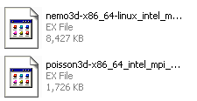
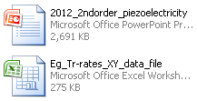
Example
Output files – data used for extracting and plotting
txt inputs
Input files(run directory)
xml/input file
submit scripts
Output plots/images
.png image
Publication images
.xls files
Origin project files
Copyright receipt
Manuscript
Review .. etc
.m files
Origin .png files
ppt - publication images
Executable files
Cover letter
.doc manuscript
ppt slide (all figures)
.xls files
Notes:
Backup on google drive. User name nanoSIUC@gmail.com

