Slide 1
ECE 424
Embedded Systems Design
Embedded Linux Overview
Chapter 8
Ning Weng

Slide 2
What’s so special about Linux?
Multiple choices vs. sole source
Source code freely available
Robust and reliable
Modular, configurable, scalable
Superb support for networking and Internet
No runtime licenses
Large pool of skilled developers

Slide 3
What is a good Embedded OS?
Modular
Scalable
Configurable
Small footprint
CPU support
Device drivers
Etc.

Slide 4
Commercial Embedded Linux
AMIRIX Embedded Linux
  derived from Debian
Coollogic Coollinux
  combines Linux and Java for Internet apps
Coventive Xlinux
  kernel can be as small as 143KB
Esfia RedBlue Linux
  400K, designed for wireless apps
And many others

Slide 5
Open Source Embedded Linux
Embedded Debian Project
  convert Debian to an embedded OS
ETLinux
  for PC104 SBC’s
uCLinux
  for microprocessors that don’t have MM
uLinux (muLinux)
  fits on a single floppy

Slide 6
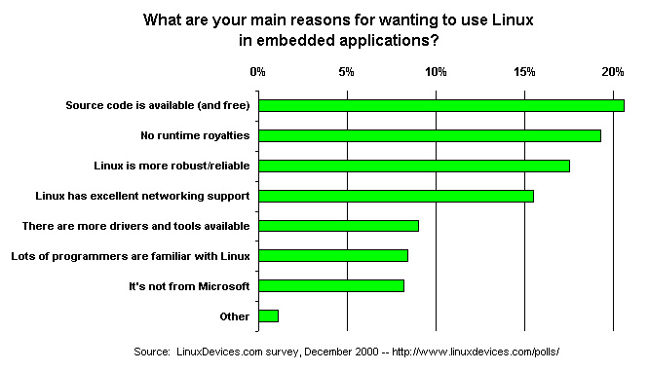
What’s so special about Linux?

Slide 7
Tool Chains
Necessary to build OS and apps
Most common are the GNU tools
Normally the target and host machine compile and build with the same environment
  Host: the machine on which you develop your applications
  Target: the machine for which you develop your applications
  Native development (same) or cross development (different)

Slide 8
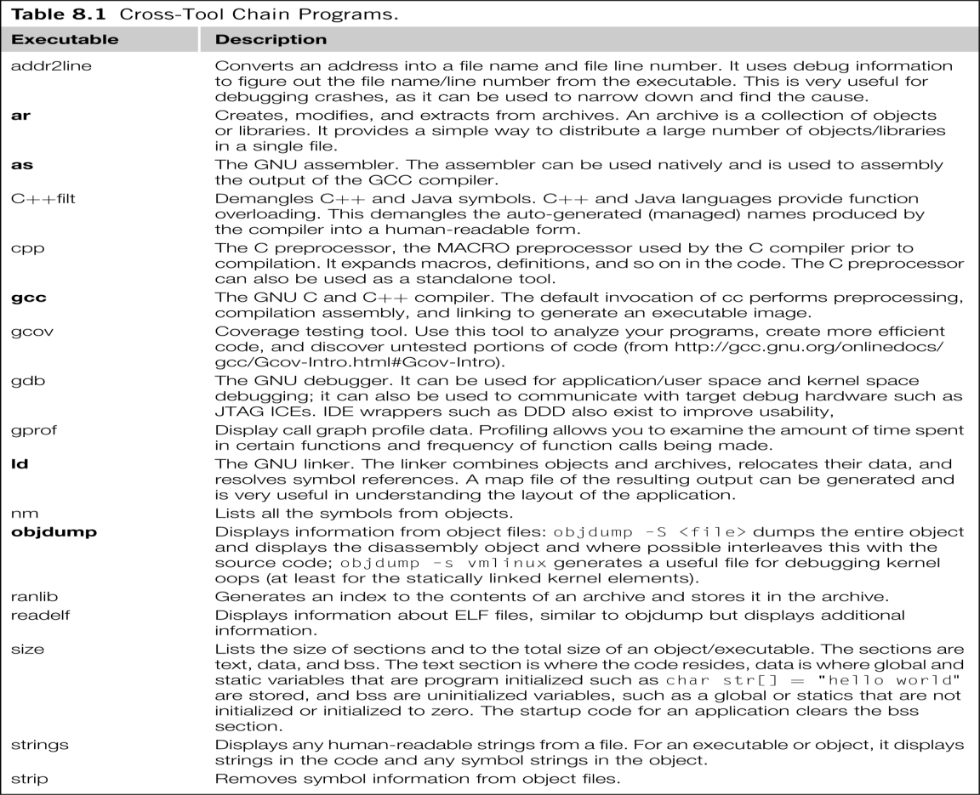
Tool Chains

Slide 9
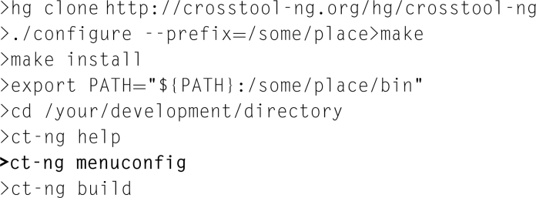
Getting Tool

Slide 10
Anatomy of Embedded Linux
Kernel
Device Drivers
Root File System

Slide 11
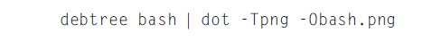
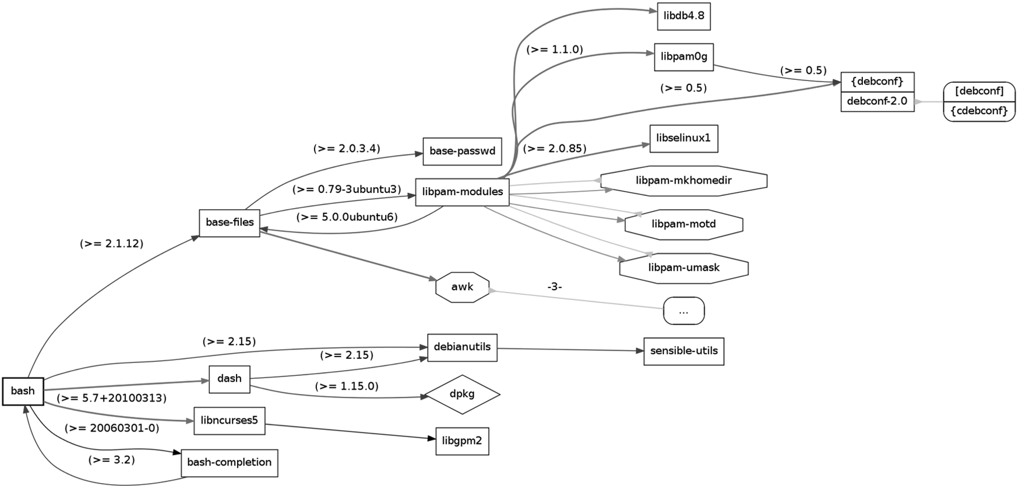
Packages Dependencies
FIGURE 8.1 Package Dependencies for the Bash shell – Bash Package.

Slide 12
The Kernel
Kernel steps:
Download the source tree
Run the tool to create the kernel .config
Build the kernel
End kernel steps
Root file system
Busybox
C library
Boot sequence

Slide 13
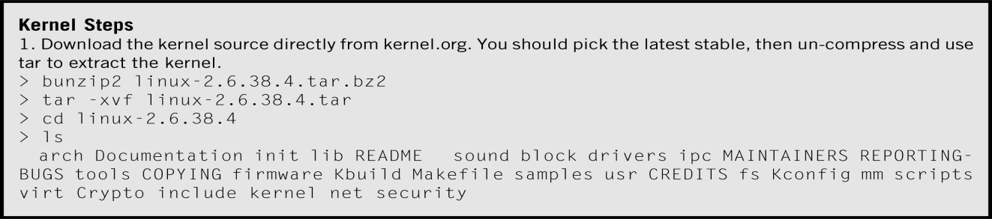
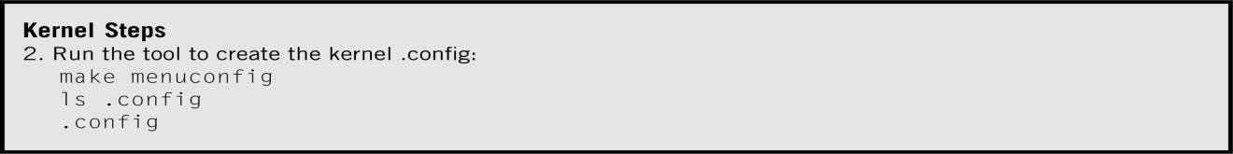
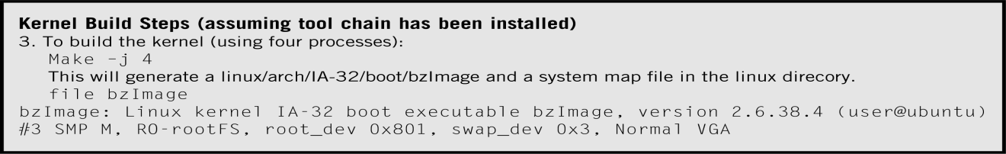
The Kernel Steps

Slide 14
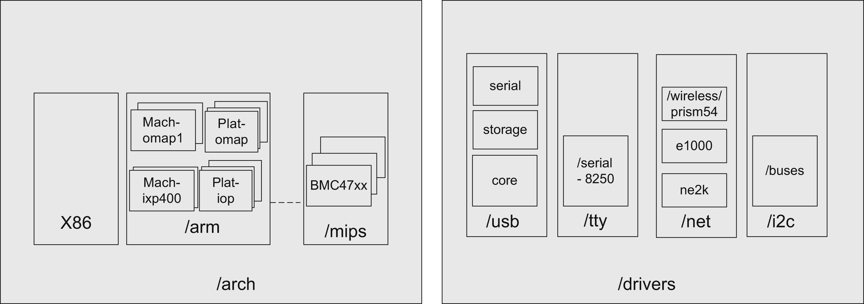
Sample Directories in Kernel Tree

Slide 15
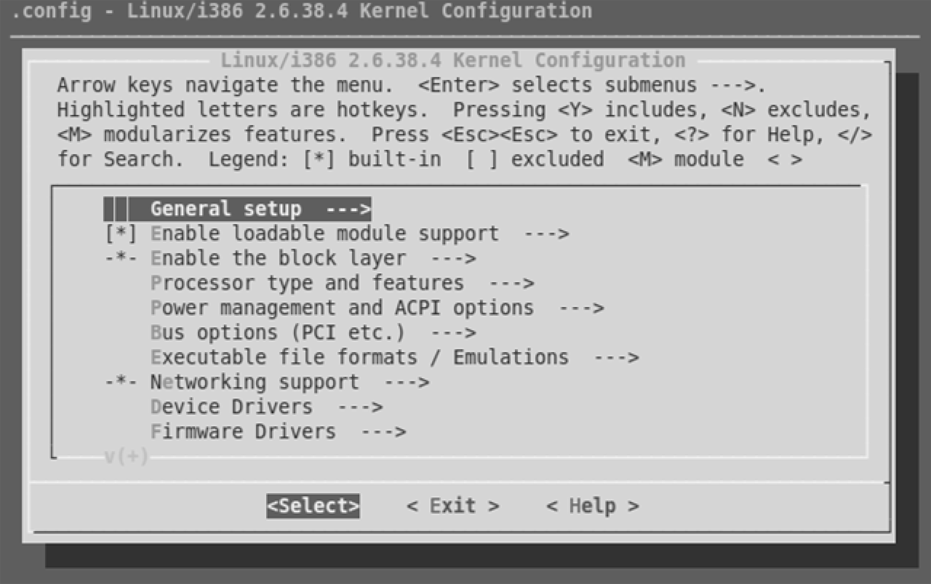
The Kernel (kernel step 2)
Three options are generated in the .config file:
CONFIG_FEATURE_XX=y
#CONFIG_FEATURE_XX not set
CONFIG_FEATURE_XX=m
EX: Xscale Intel IXP435 BSP configuration change
machine_is_ixp425()
CONFIG_MACH_IXP425
MACH_TYPE_IXP425

Slide 16
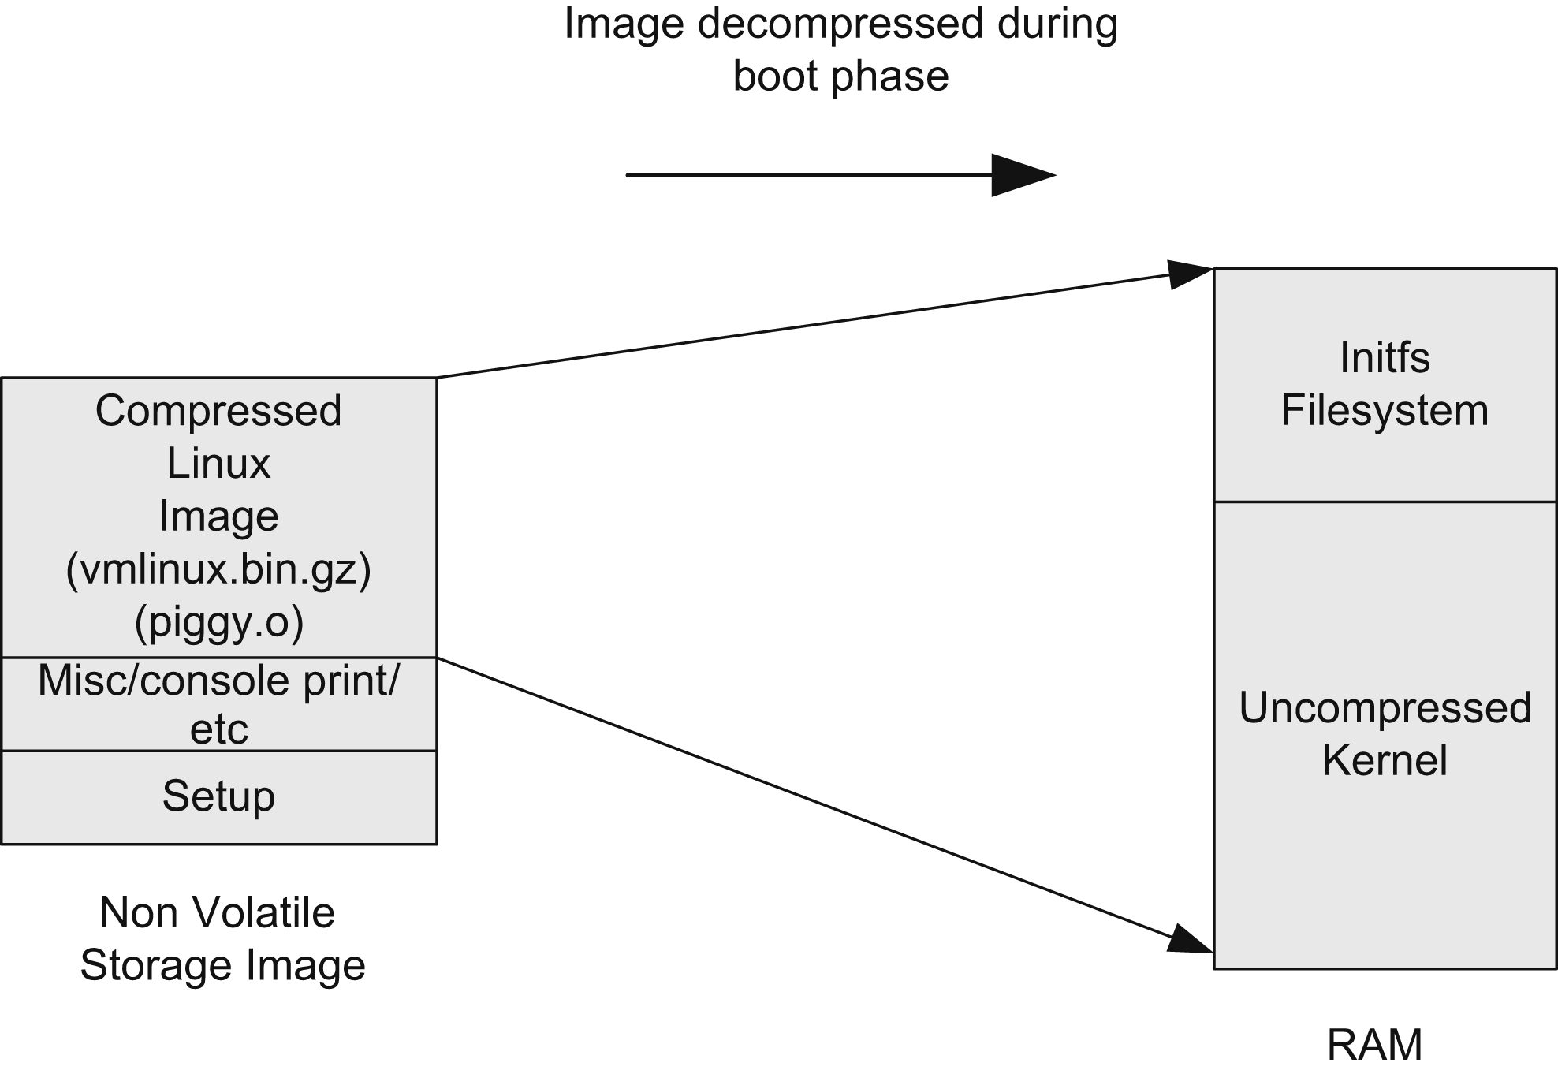
The Kernel (kernel step 3)
Why Compressed kernel image?

Slide 17
Root File System
the filesystem that is contained on the same partition on which the root directory is located,
the filesystem on which all the other filesystems are mounted (i.e., logically attached to the system) as the system is booted up (i.e., started up).
Filesystem Hierarchy Standard (FHS)
  /bin
  /dev
  /etc
  /lib
  /lib/modules
  /proc
  /root
  /sbin
  /sys
  /tmp
  /usr
  /var

Slide 18
Busybox
BusyBox combines tiny versions of many common UNIX utilities into a single small executable.
It provides replacements for most of the utilities you usually find in GNU fileutils, shellutils, etc.
The utilities in BusyBox generally have fewer options than their full-featured GNU cousins; however, the options that are included provide the expected functionality and behave very much like their GNU counterparts.
BusyBox provides a fairly complete environment for any small or embedded system.

Slide 19
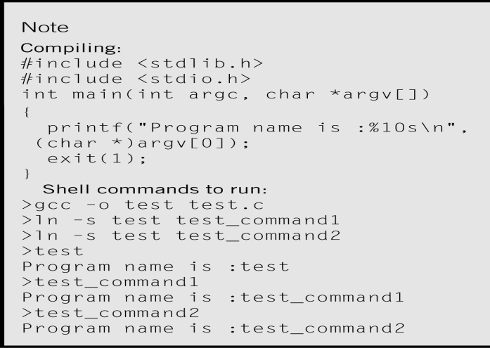
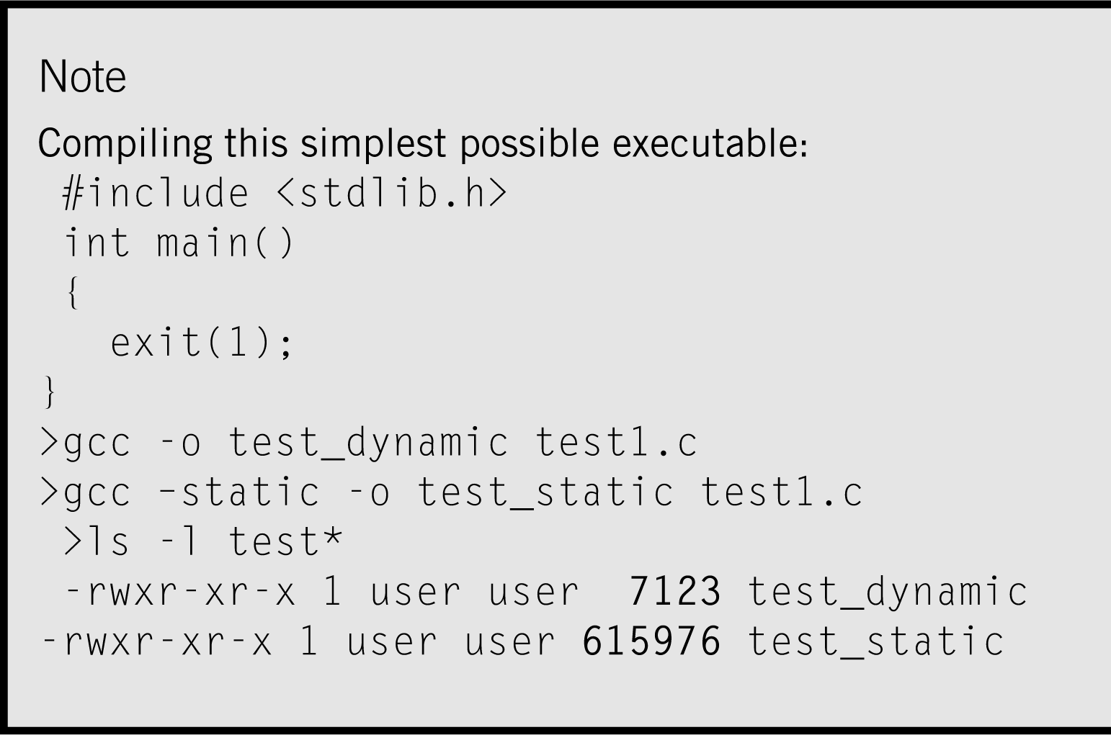
Static or Dynamic Link

Slide 20
The Kernel (C Library)
Libc: standard
GLIBC: GNU C Library
EGLIBC: Embedded GLIBC
uCLIBC: much smaller than GLIBC
Bionic C: used by Android

Slide 21
The Kernel (Boot Sequence)
BIOS or early firmware
  The first code execute by cpu after out o reset
  Initializing memory and boot devices
Boot loader
  Elilo/grub2
  Find the kernel and copy into memory and handoff to kernel
Kernel image
  bzImage
  Mass storage, along with root file system and application
  Dedicated flash area
Root file system
  Applications, libraries and scripts
  Example: NFS: a directory on the host as root file system of target

Slide 22
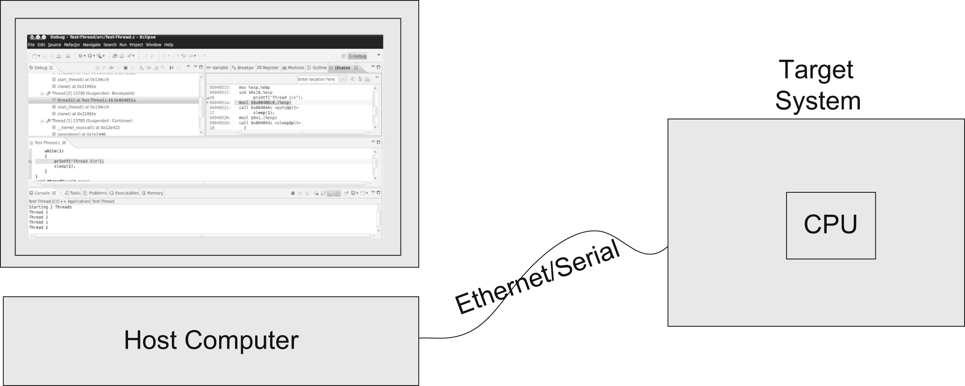
Debugging
Debugging Applications (GDB, Kdevelop, Eclipse)
Kernel debugging
QEMU Kernel Debugging

Slide 23
Driver Development
Functions of device driver:
Abstracts the hardware
Manages privilege
Enables multiplexed access
Martials Data from an application’s process to kernel space
Provides security

Slide 24
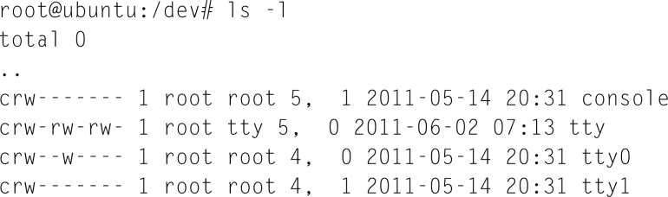
Character Driver Model

Slide 25
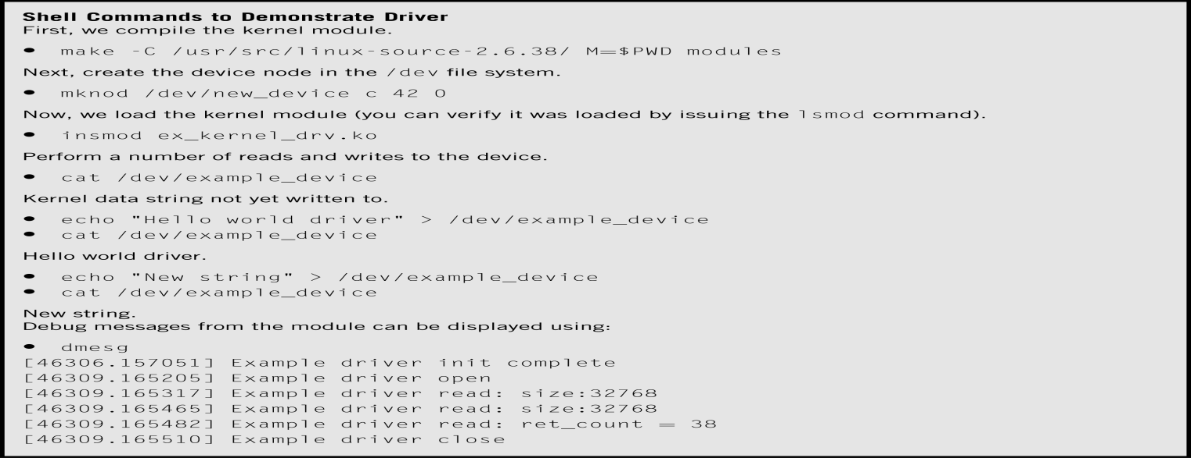
Driver Demo

Slide 26
Device Driver
General PCI device drivers Steps
Enable device
Request memory-mapped I/O Regions
Set the DMA mask size
Allocate and Initialize shared control data
Access device configuration space (if needed)
Manage the allocation of MSI/x interrupt vectors
Initialize the non-PCI capabilities
Register with other kernel sub systems
Enable the device for processing
Note: In addition to the above, networking drivers must register functions to allow TCP/IP networking stack to interact with the adaptor to transmit and receive packets.

Slide 27
Driver Development (interrupt handling & deferred work)
Interrupts:
Legacy Interrupts (INTA/ INTB/ INTC/ INTD)
Message Signal Interrupts (MSI)
Message Signal Interrupts eXtension (MSIx)
Methods to defer work from interrupt handler:
SoftIRQs
Tasklets =>
Work Queues

Slide 28
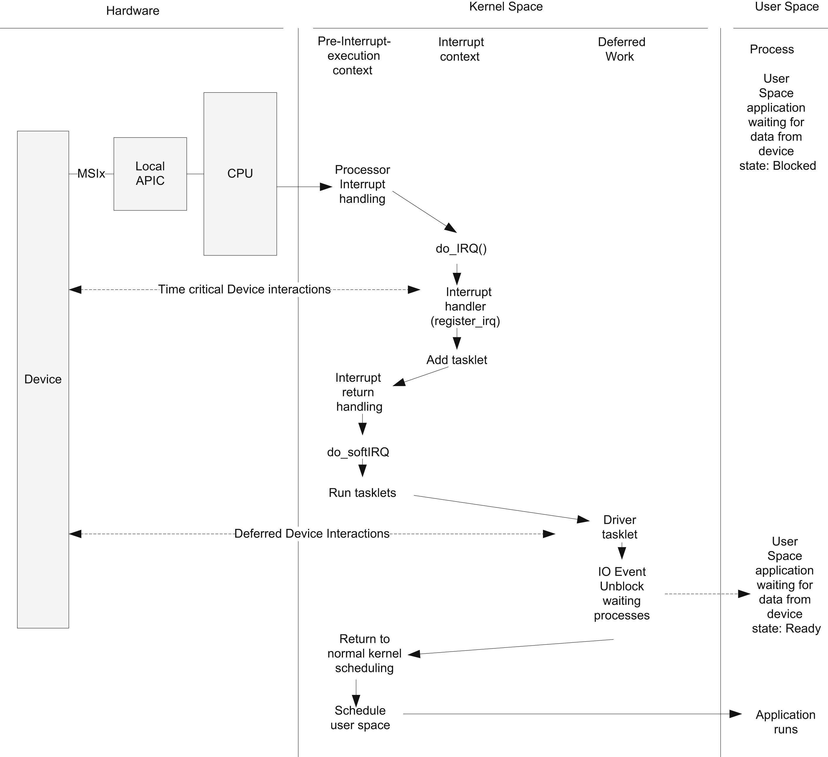

Slide 29
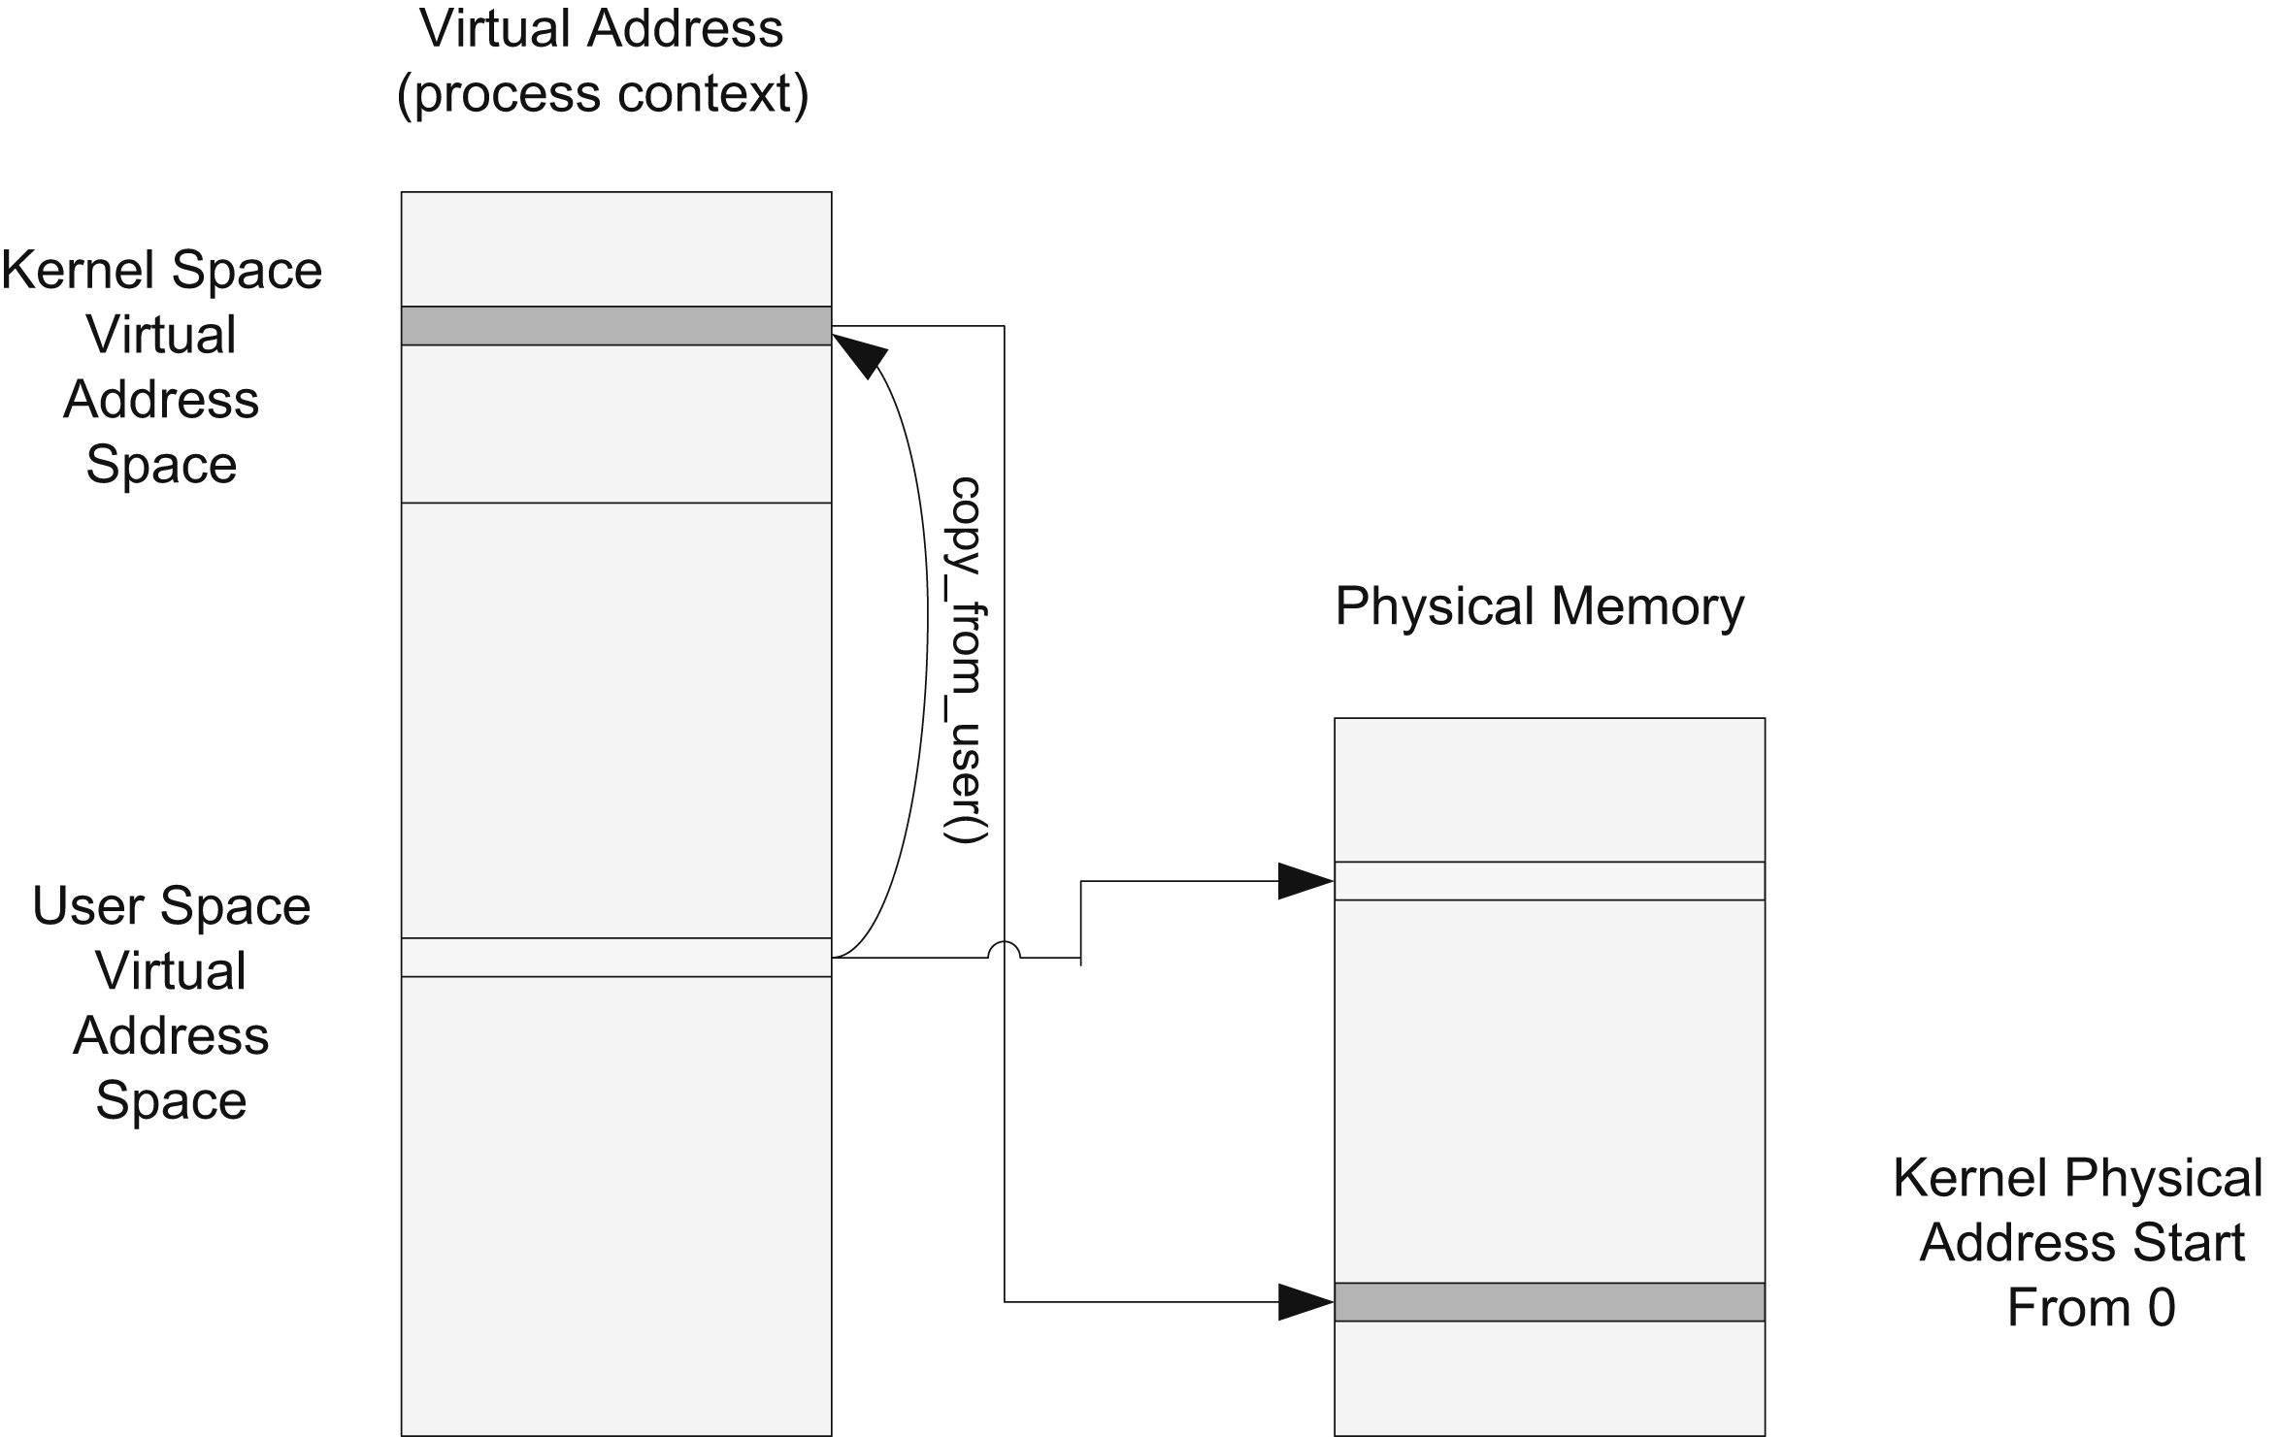
Memory Management

Slide 30
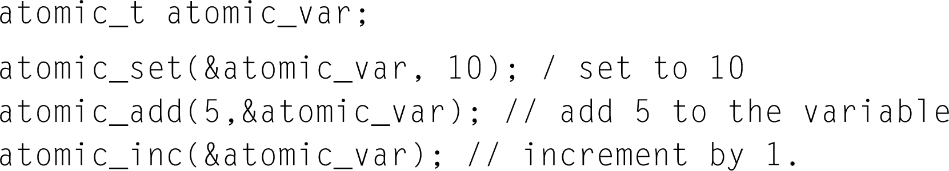
Synchronization/Locking
Primitives for synchronization and locking mechanisms to race free code
Atomic Operation: runs without being interrupted
  Use processor atomic instructions such as TSL (test set and lock), and Locked CMPXCHG (locked compare and exchange)

Slide 31
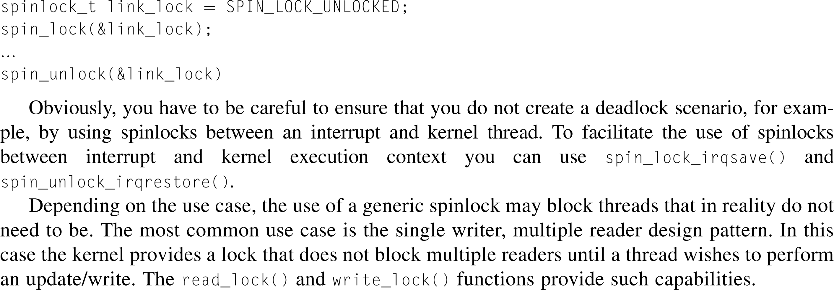
Synchronization/Locking
2. Spinlock: lock with busy wait

Slide 32
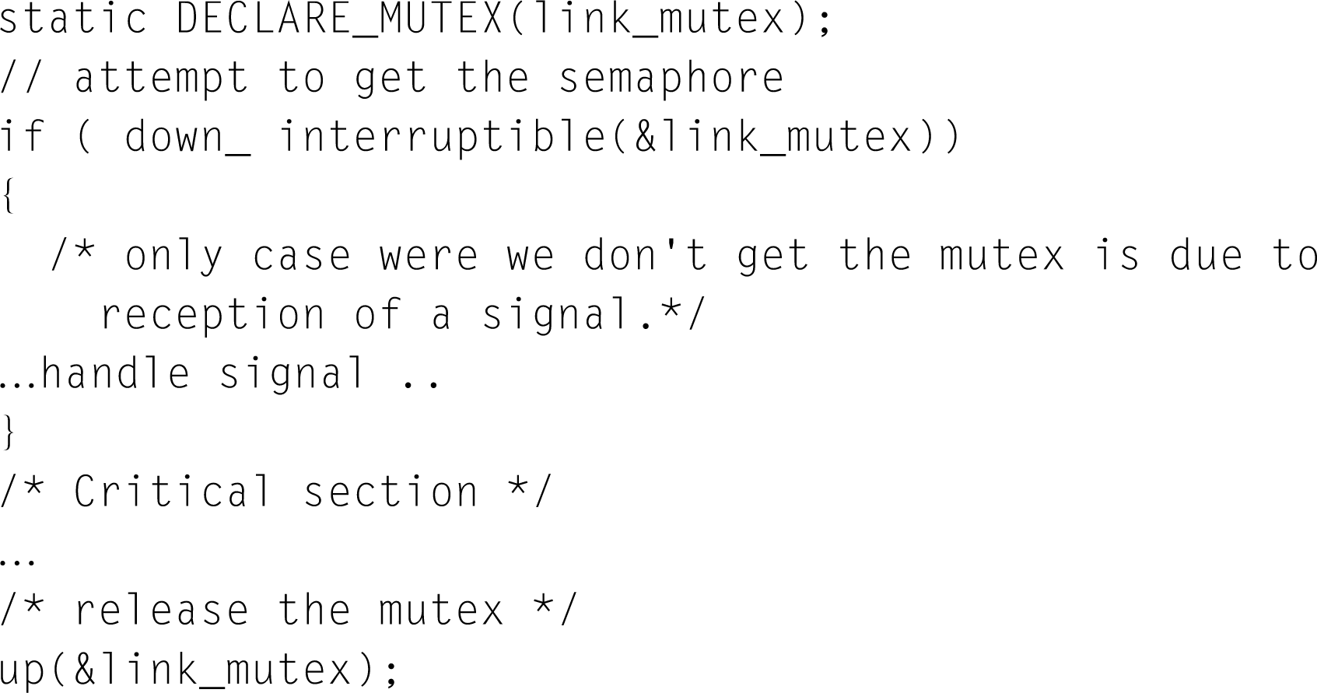
Synchronization/Locking
3. Semaphore: lock with blocking wait (sleep)

Slide 33
Conclusion
Tool Chains
The Kernel
Debugging
Driver Development
Memory Management
Synchronization/Locking

Slide 34
Announcement
Next class: Power Optimization
Exam ii: 10/31

Slide 35
Embedded Linux Programming
Cross-compiling (By ARM’s example)
Source
Code
Files
(a.c, b.c)
ARM
Object
Files
(a.o, b.o)
ARM
Executable
File
(hello)
Cross-
Compile
Link
Linux# arm-elf-gcc a.c –o a.o
Linux# arm-elf-gcc b.c –o b.o
ARM
Library
Files
(libm.a)
Linux# arm-elf-ld a.o b.o –lm –o hello

Slide 36
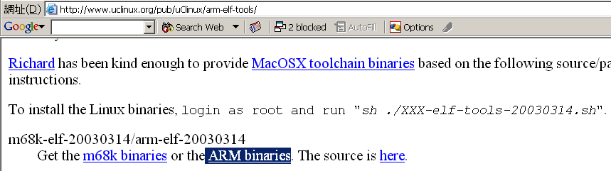
Embedded Linux Programming
Setup cross compile environment
  For Linux
    Download and install the Linux toolchain for your target board such as arm-elf- tools.
    Example: Toolchain for ARM
      First, download from uClinux.org or somewhere.

Slide 37

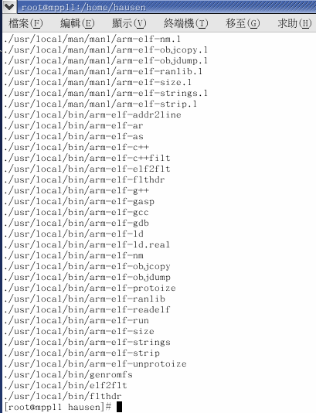
Embedded Linux Programming
      Second, install it to the proper directory. (eg. /usr/local/)
Extract the tools from
downloaded package.
You have the toolchain
installed on your system.

Slide 38
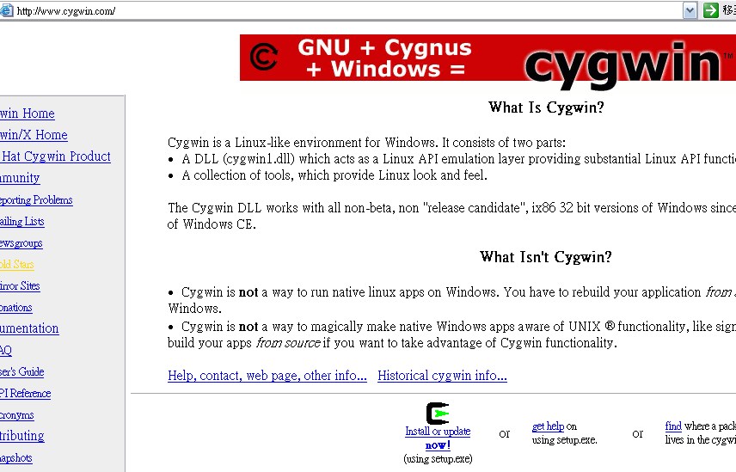
Embedded Linux Programming
  For Windows
    Ordinarily, you have to install CYGWIN to provide a Linux-like environment on Windows.

Slide 39
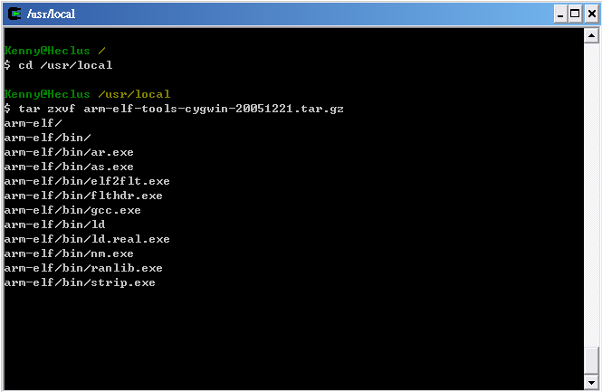
Embedded Linux Programming
    Download and install the toolchain as described before.
    Note that the toolchain must be compiled for CYGWIN.
Figure:
Cygwin provides
a Linux-like
Environment.

Slide 40
Embedded Linux Programming
Linux system programming
  Low-level File I/O
    open(), read(), write(), close(), creat(), fnctl() …
#include <unistd.h>
#include <stdlib.h>
…
int main()
{
…
/* Open /tmp/in.txt and /tmp/out.txt*/
fd1 = open(“/tmp/in.txt”, O_RDONLY | O_CREAT);
fd2 = open(“/tmp/out.txt”, O_WRONLY | O_CREAT);
if ((read(fd1, buffer, sizeof(buffer)) != sizeof(buffer))
…
if ((write(fd2, buffer, sizeof(s)) != sizeof(s))
…
close(fd1); close(fd2);
}

Slide 41
Embedded Linux Programming
  Process
    execl(), fork(), exit(), system(), wait(), getpid() …
#include <unistd.h>
…
int main()
{
pid_t new_pid;
new_pid = fork();
switch (new_pid) {
case -1 :
printf ("fork failed\n"); exit(1); break;
case 0 :
printf ("This is the child process.pid = %d\n“, getpid()); break;
default:
printf ("This is the parent process, pid = %d.\n“, getpid());
}
return 0;
}

Slide 42
Embedded Linux Programming
  Thread
    pthread_create(), pthread_join(), pthread_cancel() …
#include <pthread.h>
…
/* Prints x’s to stderr. The parameter is unused. Does not return. */
void* print_xs (void* unused)
{
while (1)
fputc (‘x’, stderr);
}
int main ()
{
pthread_t thread_id;
/* Create a new thread to run the print_xs function. */
pthread_create (&thread_id, NULL, &print_xs, NULL);
/* Print o’s continuously to stderr. */
while (1)
fputc (‘o’, stderr);
return 0;
}

Slide 43
Embedded Linux Programming
  IPC
    mmap(), munmap(), msgctl(), msgget(), msgsnd() …
…
int main (int argc, char* const argv[])
{
…
void* file_mem;
…
/* Prepare a file large enough to hold an unsigned integer. */
fd = open (argv[1], O_RDWR | O_CREAT, S_IRUSR | S_IWUSR);
lseek (fd, LENGTH+1, SEEK_SET);
…
/* Create the memory mapping. */
file_mem = mmap (0, LENGTH, PROT_WRITE, MAP_SHARED, fd, 0);
…
/* Write a random integer to memory-mapped area. */
sprintf((char*) file_mem, “%d\n”, random_range (-100, 100));
/* Release the memory (unnecessary because the program exits). */
munmap (file_mem, LENGTH);
return 0;
}

Slide 44
Embedded Linux Programming
  Signal
    signal(), alarm(), kill(), pause(), sleep() …
#include <signal.h>
…
void ouch (int sig)
{
printf ("OUCH! I got signal %d\n", sig);
signal (SIGINT, SIG_DFL);
}
main()
{
signal (SIGINT, ouch); /* Install handler for SIGINT */
while(1) /* Infinite loop until Ctrl + C is pressed */
{
printf ("Hello World!\n");
sleep(1);
}
}

Slide 45
Embedded Linux Programming
  Socket
    socket(), accept(), connect(), recv(), send() …
#include <sys/types.h>
…
main()
{
…
/* Create a socket … */
sd = socket(AF_INET,SOCK_STREAM,0);
…
/* Accept for connections and return a new socket description id
for handling the connection */
newsd = accept(sd, (struct sockaddr *) &ser_cli, &addrlen);
if(newsd < 0)
{
printf("cannot accept \n");
exit(1);
}
…
}

Slide 46
Embedded Linux Programming
uClinux for Linux programmers [11]
  Important issue → Do not support VM.
  Each process must be located at a place in memory where it can be run.
  The area of process memory must be contiguous.
  Cannot increase the size of its available memory at runtime.
  ELF executable file format is unsupported
  → FLAT format instead.

Slide 47
Embedded Linux Programming
  The implementation of mmap() within the kernel is also quite different.
  The only filesystem that currently guarantees that files are stored contiguously → romfs.
  Only read-only mappings can be shared
  → To avoid the allocation of memory.
  Copy-on-write feature is unsupported
  → Use vfork() instead of fork(). (Discuss later)
  The stack must be allocated at compile time
  → Must be aware of the stack requirements.

Slide 48
Embedded Linux Programming
  fork() vs. vfork()
Parent
fork()
Parent
vfork()
.
.
.
fork()
.
.
.
.
.
.
fork()
.
.
.
Child
Child
.
.
write()
.
.
.
.
write()
.
exit()
Continue
executing
Suspended
Non-blocking
Data
Copy-on-write
Dynamic
allocated
Data
Use parent’s stack and data
may corrupt the data or
the stack in the parent.

Slide 49
Embedded Linux Programming
Example: A DHCP Client: udhcp (script.c)
void run_script(struct dhcpMessage *packet, const char *name)
{
…
envp = fill_envp(packet);
/* call script */
pid = vfork();
if (pid) { /* Parent */
waitpid(pid, NULL, 0);
…
} else if (pid == 0) { /* Child */
/* exec script */
execle(client_config.script, client_config.script, name, NULL, envp);
exit(1);
}
}

Slide 50
Embedded Linux Programming
Linux device driver fundamentals [12]
Figure:
The split view
of the kernel.

Slide 51
Embedded Linux Programming
The role of device driver
  To allow interaction with hardware devices.
  Providing mechanism, not policy.
    What capabilities are to be provided? → mechanism
    How those capabilities can be used? → policy
Writing a Linux device driver
  Pre-requisites
    C programming
    Microprocessor programming
  Important concepts
    User space vs. kernel space

Slide 52
Embedded Linux Programming
Execution paths: From user to kernel

Slide 53
Embedded Linux Programming
Classes of devices
  Characters devices
    Can be accessed as a stream of bytes.
    Such a driver usually implements at least the open, close, read, and write system calls.
    Example: RTC driver.
  Block devices
    A device (e.g., a disk) that can host a filesystem.
    Example: Ramdisk driver.
  Network interfaces
    In charge of sending and receiving data packets, driven by the network subsystem of the kernel.
    Example: Network card driver.

Slide 54
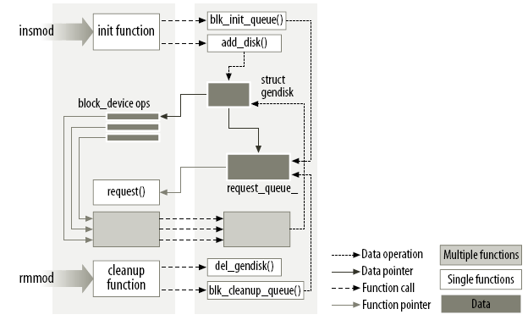
Embedded Linux Programming
Kernel Module: Life and Death
Figure:
Linking a module
to the kernel. [12]

Slide 55
Embedded Linux Programming
The first kernel module “Hello, world”
#include <linux/init.h>
#include <linux/module.h>
MODULE_LICENSE(“Dual BSD/GPL”);
static int hello_init(void)
{
printk(KERN_ALERT “Hello, world\n”);
return 0;
}
static void hello_exit(void)
{
printk(KERN_ALERT “Goodbye, cruel world\n”);
}
module_init(hello_init);
module_exit(hello_exit);

Slide 56
Embedded Linux Programming
Some other types of kernel modules
  USB Module
  Serial Module
  SCSI Module
  PCI Module
  I2C Module
  Misc Module
  …
Topics you also need to be concerned about
  Memory allocating
  Interrupt handling
  Concurrency and race condition
  I/O accessing
  Time, delays and deferred work

