Slide 1
Lecture 4: Embedded Application Framework Qt Tutorial Cheng-Liang (Paul) Hsieh
ECE 424 Embedded Systems Design

Slide 2
What is QT?
A software development framework
Qt framework
APIs
Qt Creator IDE
Design and debug
Tools and toolchains
Simulator, complier, device toolchains
Qt is released on 1991 by Trolltech
Nokia acquired Trolltech in 2008
Free and open source software to puclic
C+ is the primary programming language

Slide 3
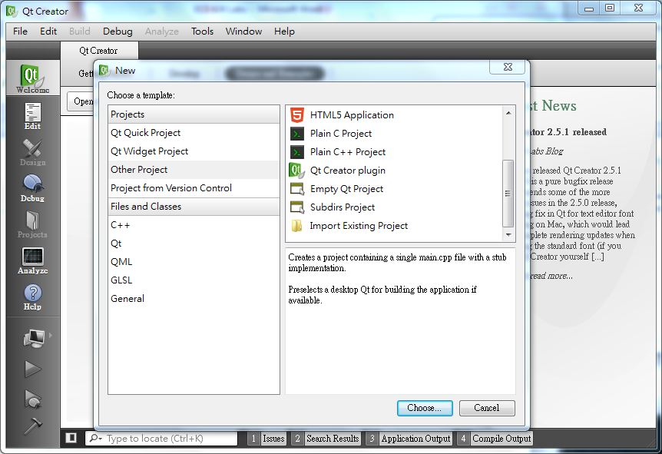
How does Qt IDE look like?

Slide 4
Why choose QT for our labs?
Qt is a cross-platform development framework
Coding once then porting to any supported platform
Qt is language-independent development framework
C++
Pythone
Jave
C#
Qt aims at development efficiency. Android aims at system-level resource utilization
Plenty of modules are ready in QT and all of them are free to use.

Slide 5
Why choose to make a health gateway application for our labs?
Medical devices are known are typical embedded systems
Growing telehealth medical devices market
Chronic disease
Better average life expectancy
Telehealth devices’ characteristics
Need to be compatible with current networking environment
Security function is necessary

Slide 6
How to start?
Qt software Development Kit
http://qt.nokia.com/products/qt-sdk/
Qt Reference
http://doc.qt.nokia.com/
Useful Books
C++ GUI Programming with Qt 4, ISBN: 0132354160
http://www.qtrac.eu/C++-GUI-Programming-with-Qt-4-1st-ed.zip
An Introduction to Design Patterns in C++ with Qt 4, ISBN:0131879057
Foundations of Qt Development, ISBN: 1590598318
The Book of Qt 4: The Art of Building Qt Applications, ISBN: 1593271476

Slide 7
How to start Qt programming?
Step 1: Regain your knowledge about C++
Input and Output
Function
Pointer, Reference, and Memory access
Operator
Overloaded function
Classes
Member access specifier
Public
Protected
Private

Slide 8
How to start Qt programming?
Class examples
#ifndef _FRACTION_H_
#define _FRACTION_H_
#include <string>
using namespace std;
class Fraction {
public:
void set(int numerator, int denominator);
double toDouble() const;
string toString() const;
private:
int m_Numerator;
int m_Denominator;
};
#endif
In you code, you can do followings:
Fraction f1,f2;
f1.set(1,2);
f2.set(3,4);
You cannot do followings:
f1.m_Numerator=12;
f1.m_Denominator=34;
But you can assign values to private values through public functions with initial list.

Slide 9
How to start Qt programming?
Step 2: Regain object-oriented programming skill
Object Oriented Programming
Encapsulation
Packaging data
Providing well-documented public functions
Hiding implementation detail
Inheritance
Allows different classes to share code
Derived class inherits base class and overwirte/extent functions in base class to meet our needs.
Polymorphism
Virtual function/ Indirect calls/ dynamic binding

Slide 10
How to start Qt programming?
Step 3: Know Qt Modules
QtCore
Core non-GUI functionality
QtGui
Extend QtCORE with GUI functionality
QtMultimedia
Low level multimedia functionality
QtNetwork
QtOpenGL
QtSql
QtWebkit

Slide 11
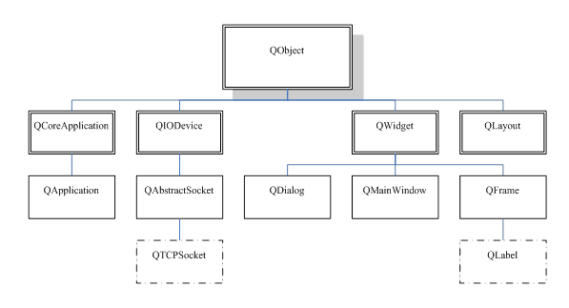
How to start Qt programming?
Step 3.1: Get familiar with QObject
Base class in Qt and it works as identities
Signals and slots mechanism
Inheritance Tree of QObject class

Slide 12
How to start Qt programming?
Step 3.2: Parent-Child relationship
One parent object and arbitrary number of children
Each QObject parent manages its children
The child list establishes a bi-directional association
Parent objects should not be confused with base classes

Slide 13
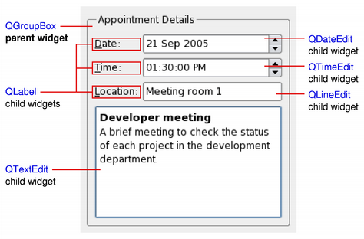
How to start Qt programming?
QWidget
QWidget
The base class of all user interface objects,
The widget is the atom of the user interface
A widget that is not embedded in a parent widget is called a window.

Slide 14
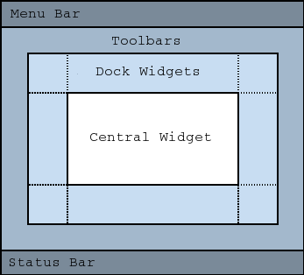
How to start Qt programming?
Qdialog and QMainWindow
QDialog
Options and choices
Modal or modeless
QMainWindow
Note: Creating a main
window without a central
widget is not supported

Slide 15
Example: Hello Qt!
Code #1
#include <QApplication>
#include <QLabel>
int main(int argc, char *argv[])
{
QApplication app(argc, argv);
QLabel *label = new QLabel("Hello Qt!");
label->show();
return app.exec();
}

Slide 16
Example: Hello Qt!
Code #2: Signal & Slot mechanism
#include <QApplication>
#include <QPushButton>
int main(int argc, char *argv[])
{
QApplication app(argc, argv);
QPushButton *button = new QPushButton("Quit");
QObject::connect(button, SIGNAL(clicked()), &app, SLOT(quit()));
button->show();
return app.exec();
}

Slide 17
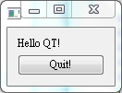
Example: Hello Qt!
Code #3: How to combine code#1 and code#2
#include <QApplication>
#include <QLabel>
#include <QPushButton>
#include <QVBoxLayout>
#include <QWidget>
int main (int argc, char *argv[])
{
QApplication app(argc, argv);
QWidget *window = new QWidget;
QLabel *label = new QLabel("Hello QT!");
QPushButton *button = new QPushButton("Quit!");
QVBoxLayout *layout = new QVBoxLayout;
layout->addWidget(label);
layout->addWidget(button);
QObject::connect(button, SIGNAL(clicked()),&app,SLOT(quit()));
window->setLayout(layout);
window->show();
return app.exec();
}

Slide 18
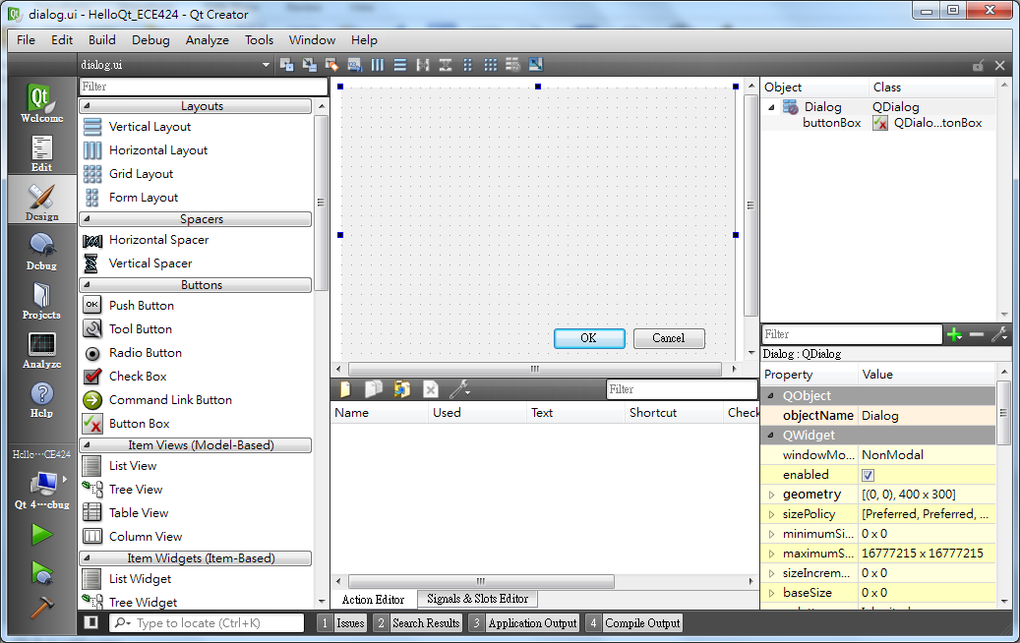
Example: Hello Qt!
Code #4: “Hello Qt!” by QT Designer

