Slide 1
ECE 424
Embedded Systems Design
Lecture 8 & 9 & 10:
Embedded Processor Architecture
Chapter 5
Ning Weng

Slide 2
Introduction
Concepts with processor within SOC
  Focus on 32 bit
  Large data set, high performance and complex applications
Basic execution environment
Application binary interface
Instruction classes
Interrupts
Memory mapping and protection
Memory hierarchy

Slide 3
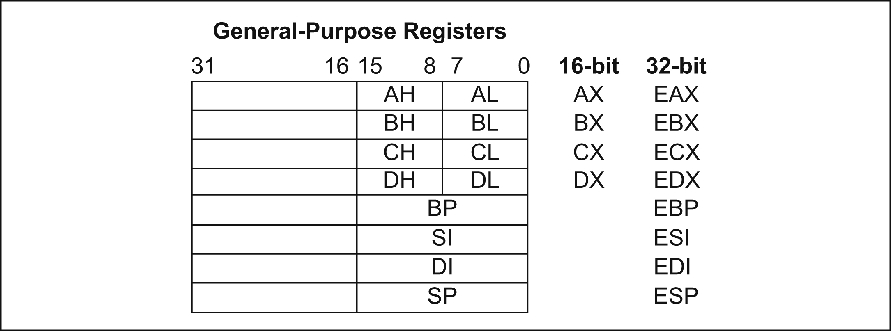
Basic Execution Environment
ARM and PowerPC
  Generalized Registers
Intel
  Segment Registers

Slide 4
Basic Execution environment
Instruction Pointer
  Program counter maintained by the CPU
  ARM vs. Intel
    ARM allows direct modification
    Intel uses Extended Instruction Pointer (EIP)
Flags
  Status Flags
      ADD, SUB, and MUL
  Additional bit flags
      Information for the programmer and OS.

Slide 5
Basic Execution environment
Stack Pointer
  Program stacks are created in system memory
    Store local variables, allocate storage, pass function arguments
Base Pointer
  Allows a program to manage the function calling hierarchy on the stack.
  Memory Dump
  Also known as frame pointer

Slide 6
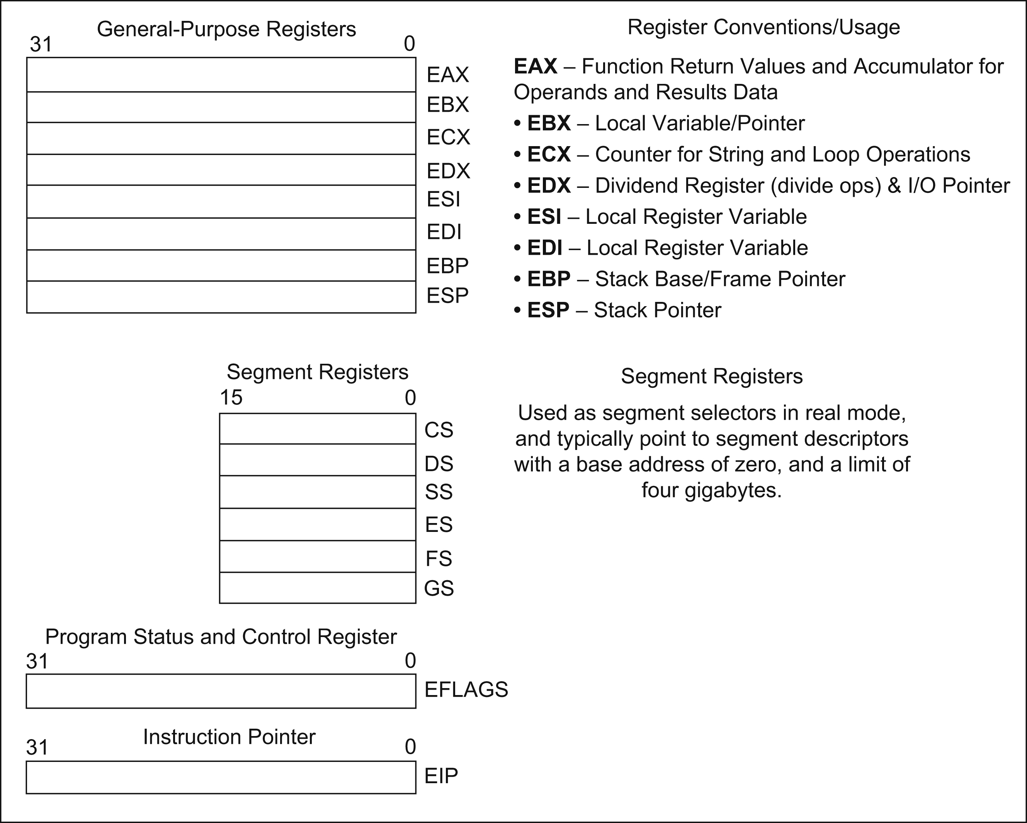
Execution Environment

Slide 7
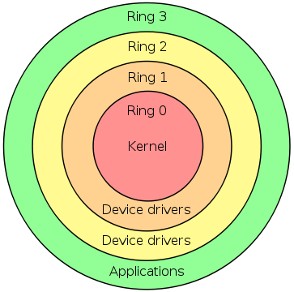
Privilege Levels
Different levels are provided for security and resource access control
  Highest privilege (0) for OS and lowest privilege (3) for user programs
  Helps manage system resources
  Level 0
    Linux – Kernel Mode
    Windows – Ring 0

Slide 8
Processor Specifics
Intel specific CPUID instruction
  Instructions to display the feature set of a processor
  Helps in performance tuning
  Example
    Linux command /cat/proc/cpuinfo utilizes CPUID instruction
RDTSC
  Returns the maximum number of ticks at maximum processor frequency
  Very accurate

Slide 9
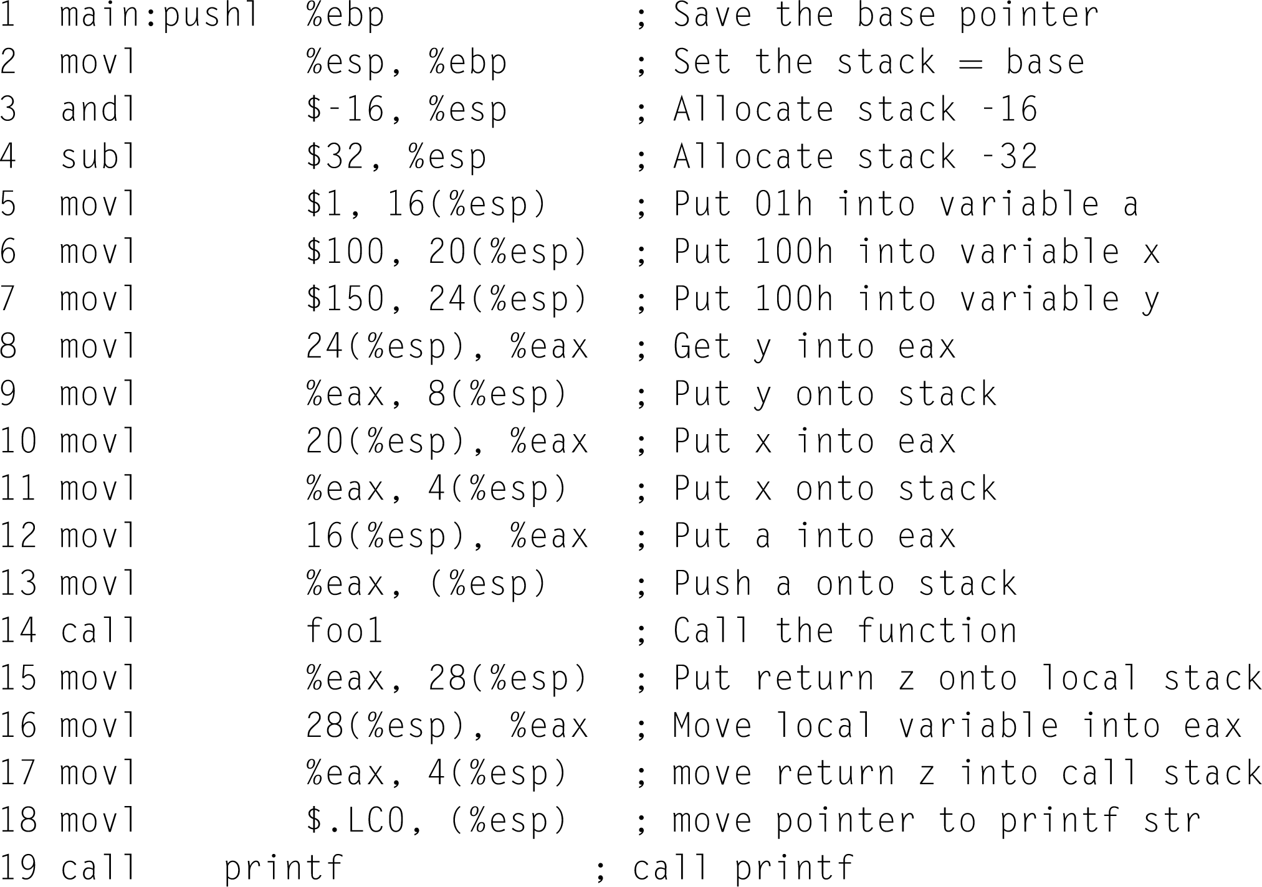
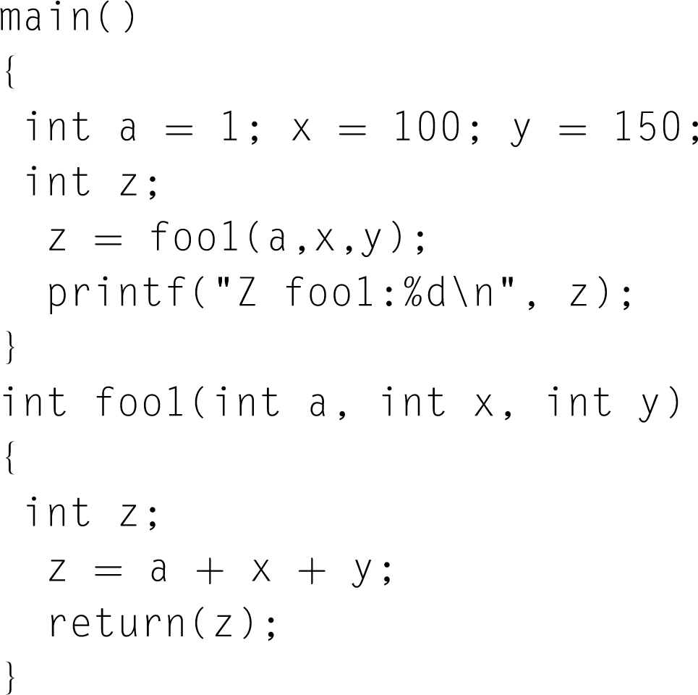
Application Binary Interface
Describes the low-level interface between an application and the operating system
  Useful for debugging

Slide 10
Processor Instruction Classes
Immediate Operands
  MOV EAX, 00
Register Operands
  Source/Destination can be almost any register (RISC)
Memory Operands
  MOV [EBX], EAX
Data Transfer Instructions
  MOVNTI

Slide 11
Processor Instruction Classes
Arithmetic Instructions
  ALU
Binary Operations
Decimal Operations
Logical Operations
  AND, OR, XOR, NOT
Shift Rotate Operations
Bit/Byte Operations
Tables on page 116-117

Slide 12
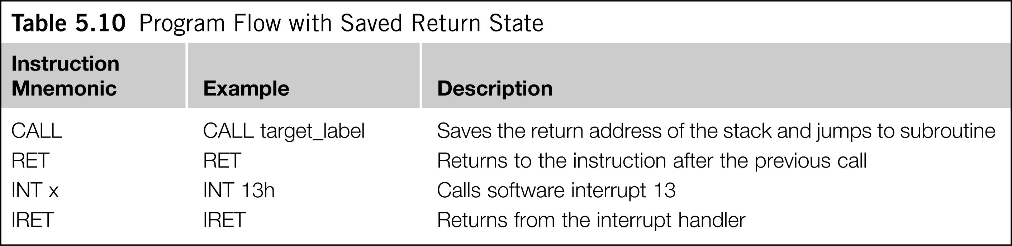
Branch and Control Flow Instructions
Needed to control the flow of a program’s execution
  Examples
    Jmp, LOOP, CALL, RET

Slide 13
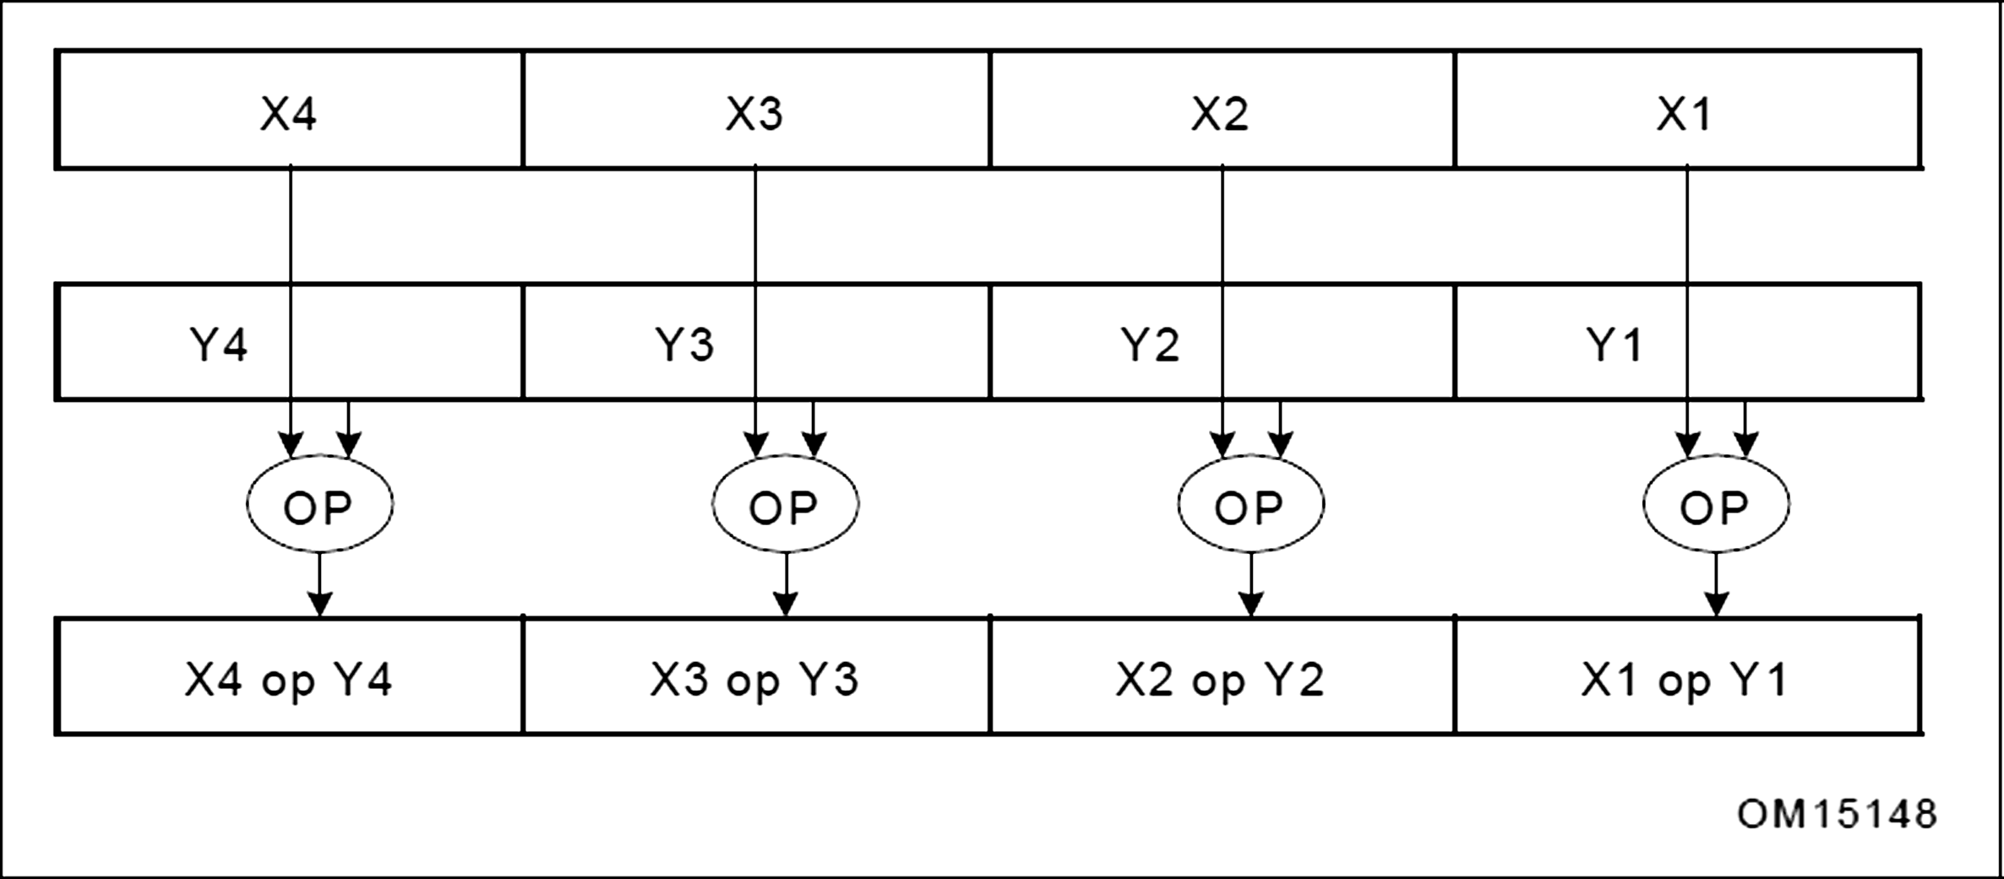
SIMD Instructions
Single Instruction Multiple Data
  Intel SSE
  Used to optimize:
    Speech recognition algorithms
    Video display and capture routines
    3D graphics
    Encryption algorithms
  In theory, the speed up is 75% over SISD instructions

Slide 14
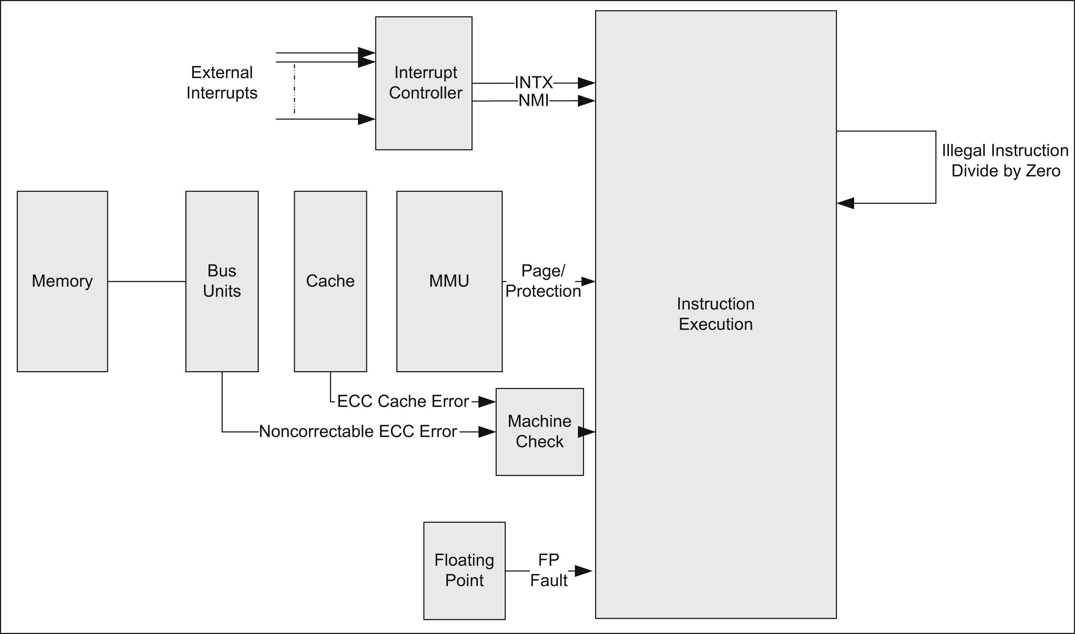
Exception/Interrupt Sources

Slide 15
Vector Table Structure
PowerPC and ARM
  Look up vector table using software
Intel
  Processor itself identifies fault without software
Segment Selector
  Selects segment from descriptor table
Segment Offset
  Produces the linear address
Privilege Level
  Set to zero

Slide 16
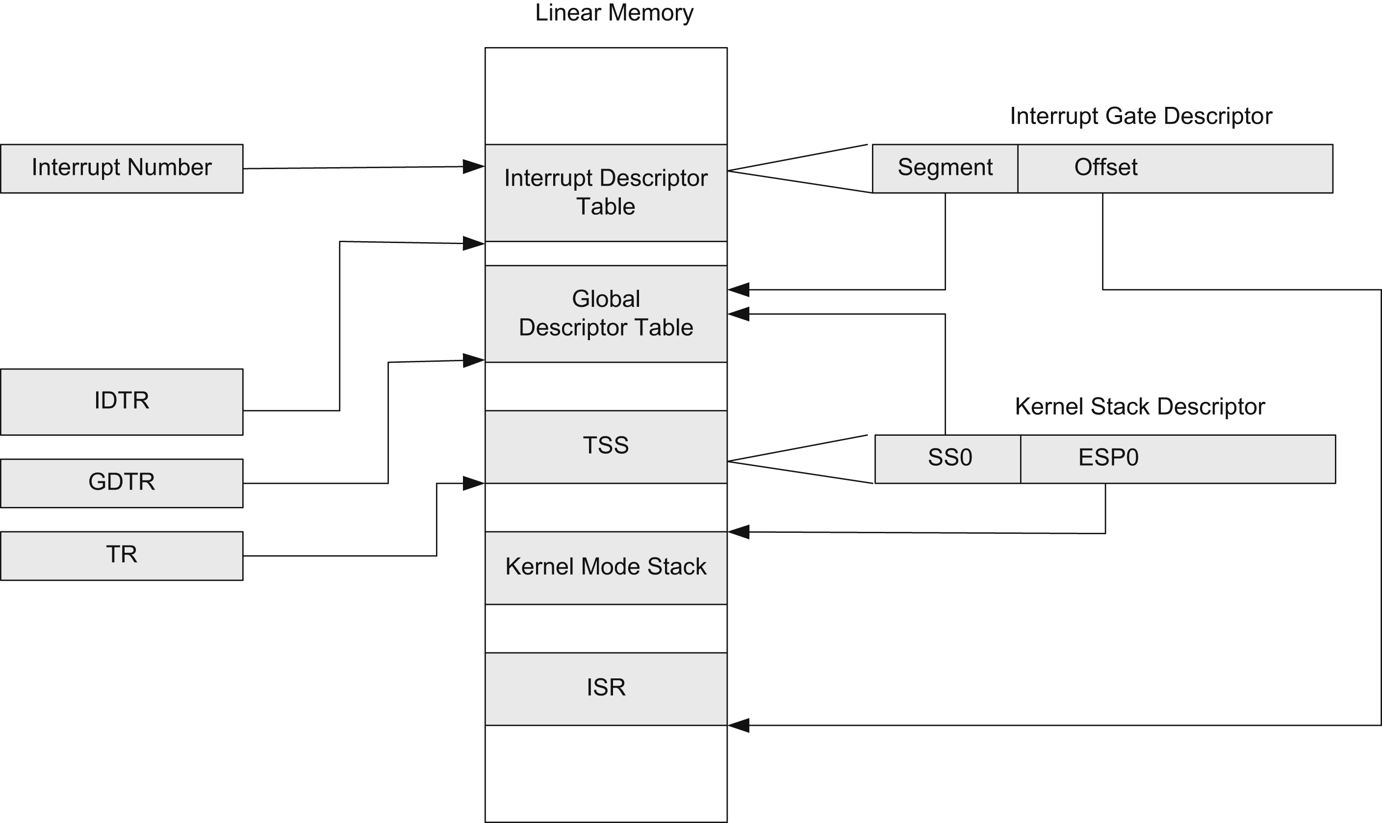
Interrupt Descriptor Dereferencing

Slide 17
Masking Interrupts
Exception frame
  Format of saved interrupt/exception data
Masking Interrupts
  Pros
    Disable during parallel pointer operations
  Cons
    Can be processed by other hardware threads
    Degrades system performance

Slide 18
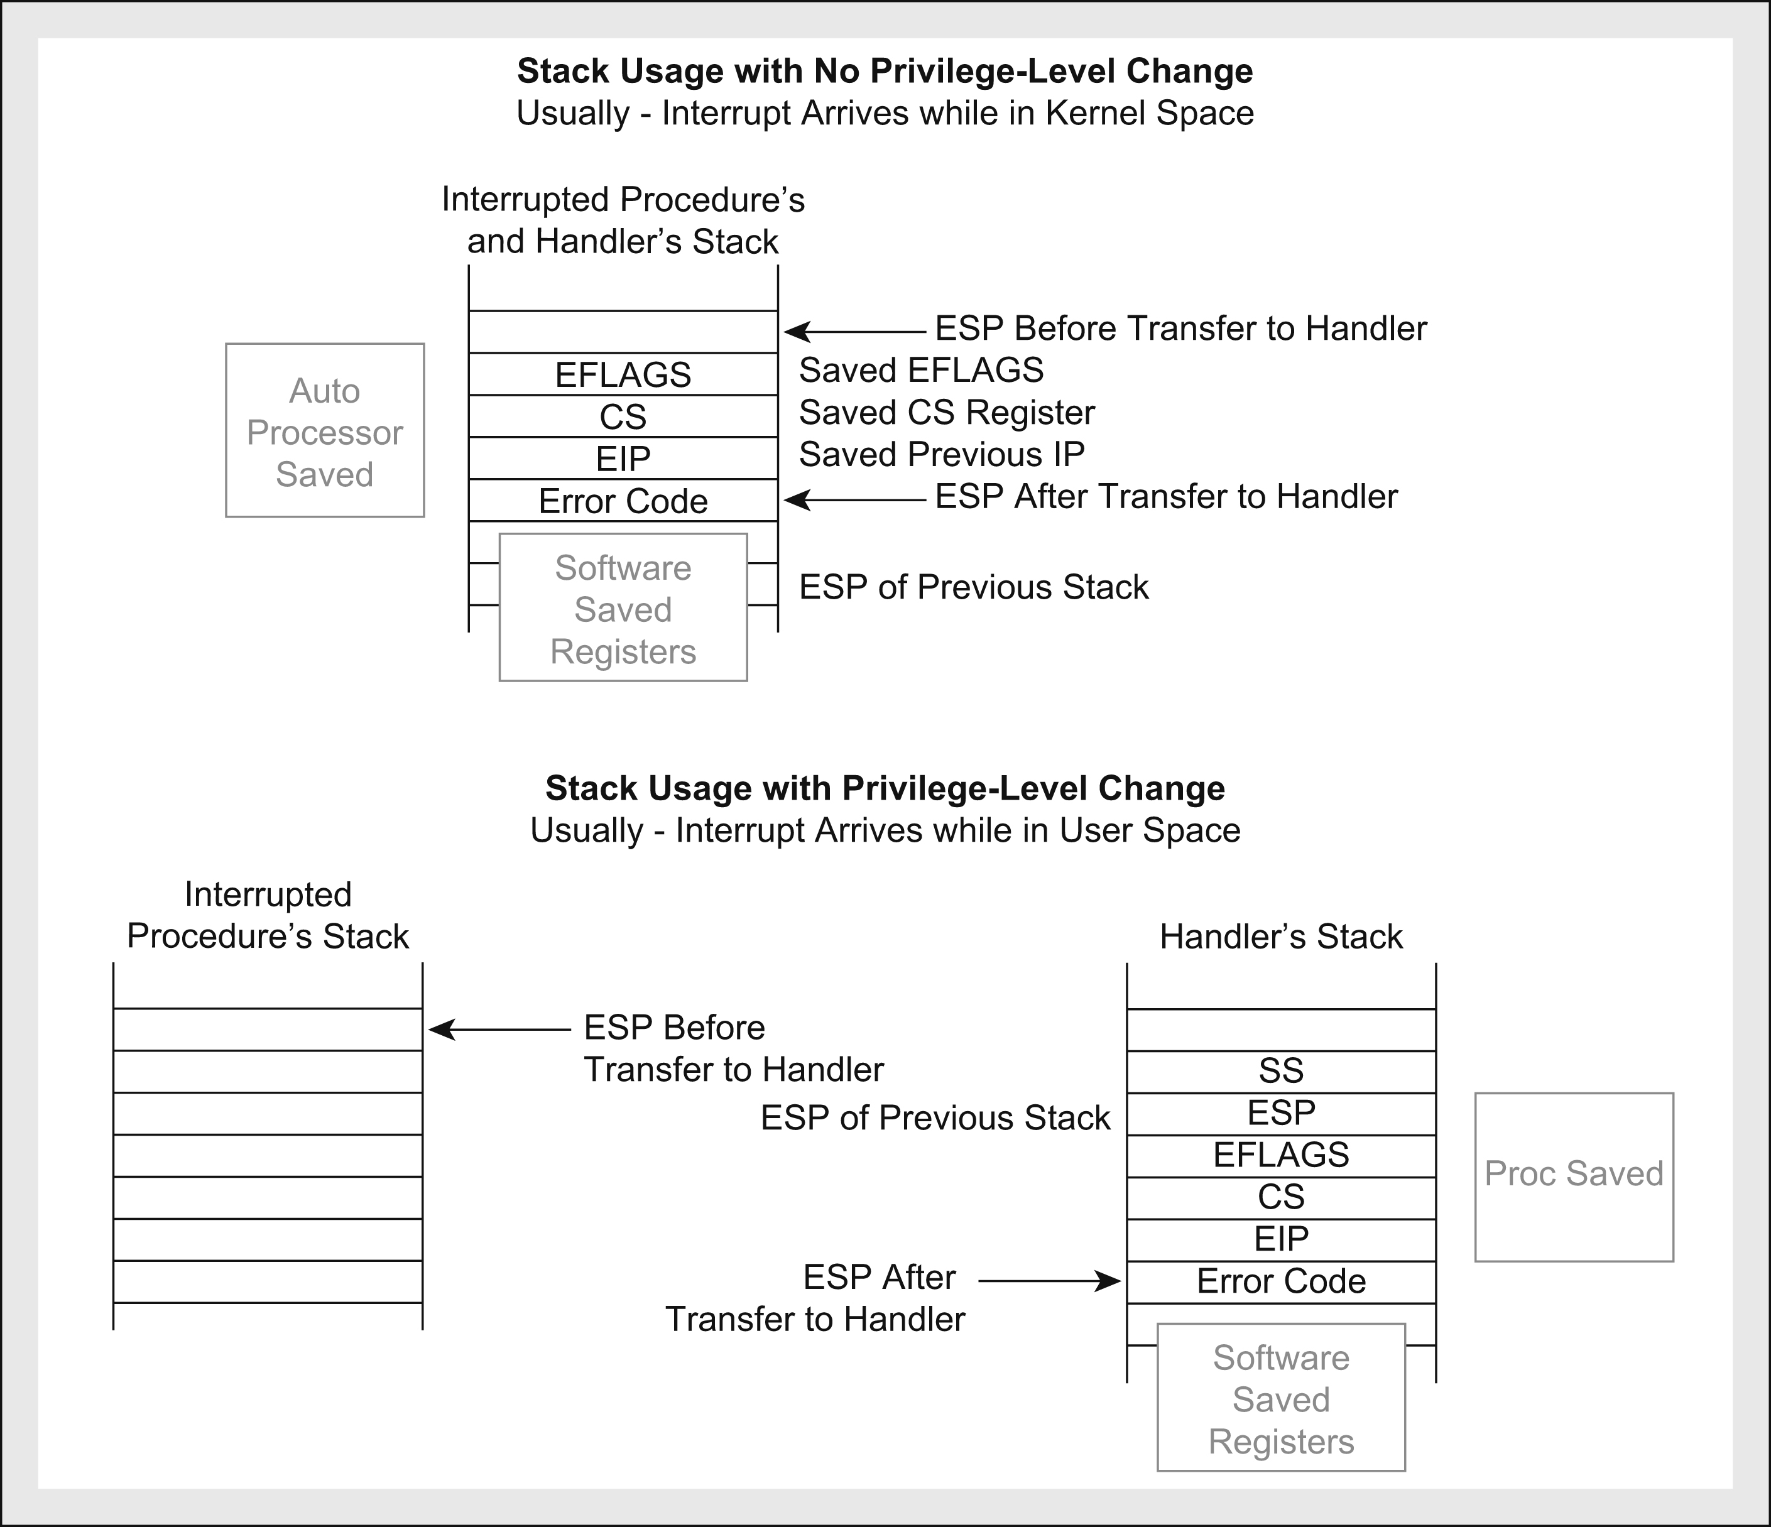
Stack Frames

Slide 19
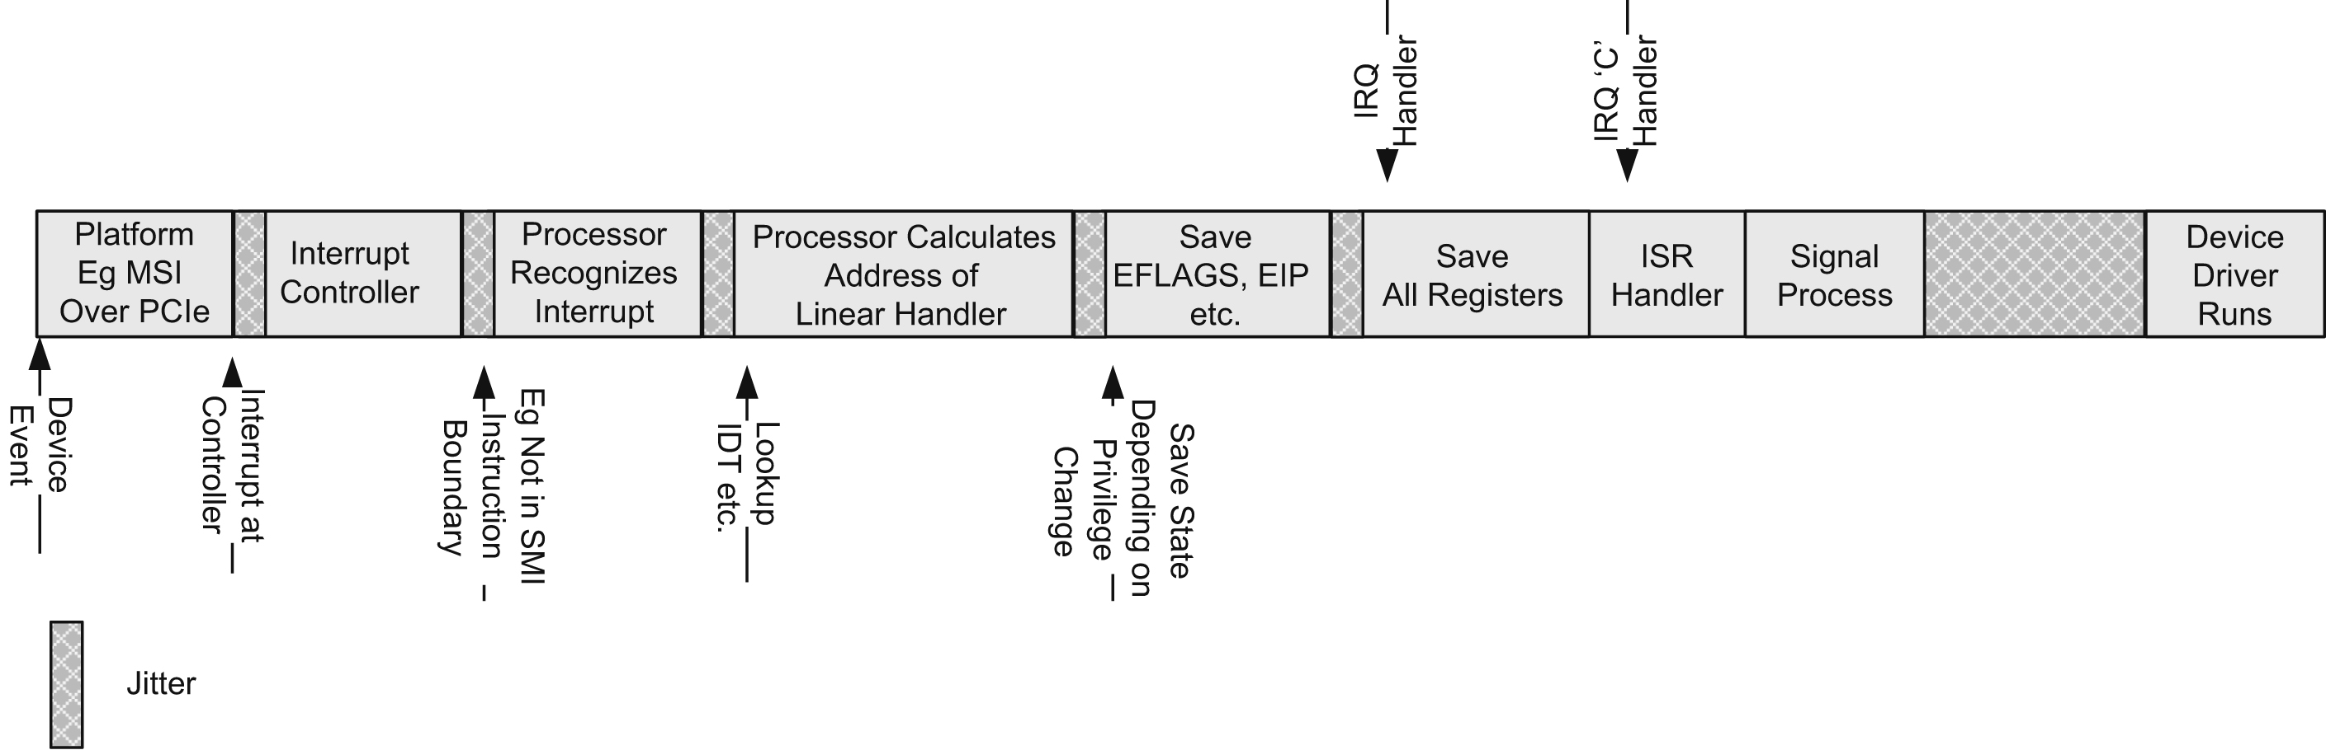
Components of Interrupt Latency

Slide 20
Memory Mapping and
Protection
Memory Protection Unit (MPU)
  Defines valid parts of the system memory map and access control
  Regulates cacheable memory regions
Memory Management Unit (MMU)
  Protection and fine-grained address translation between linear/virtual and physical address
  A building block of a virtual memory system
  Allows OS to overcommit memory on applications by moving data from and to disks via scheme paging
  Paging increasing memory efficiency by moving infrequently-used part of programming working memory from RAM to disk.
  The unit of transfer is a fixed-sized called page
  Page fault: thousand of cycles, not used for embedded systems

Slide 21
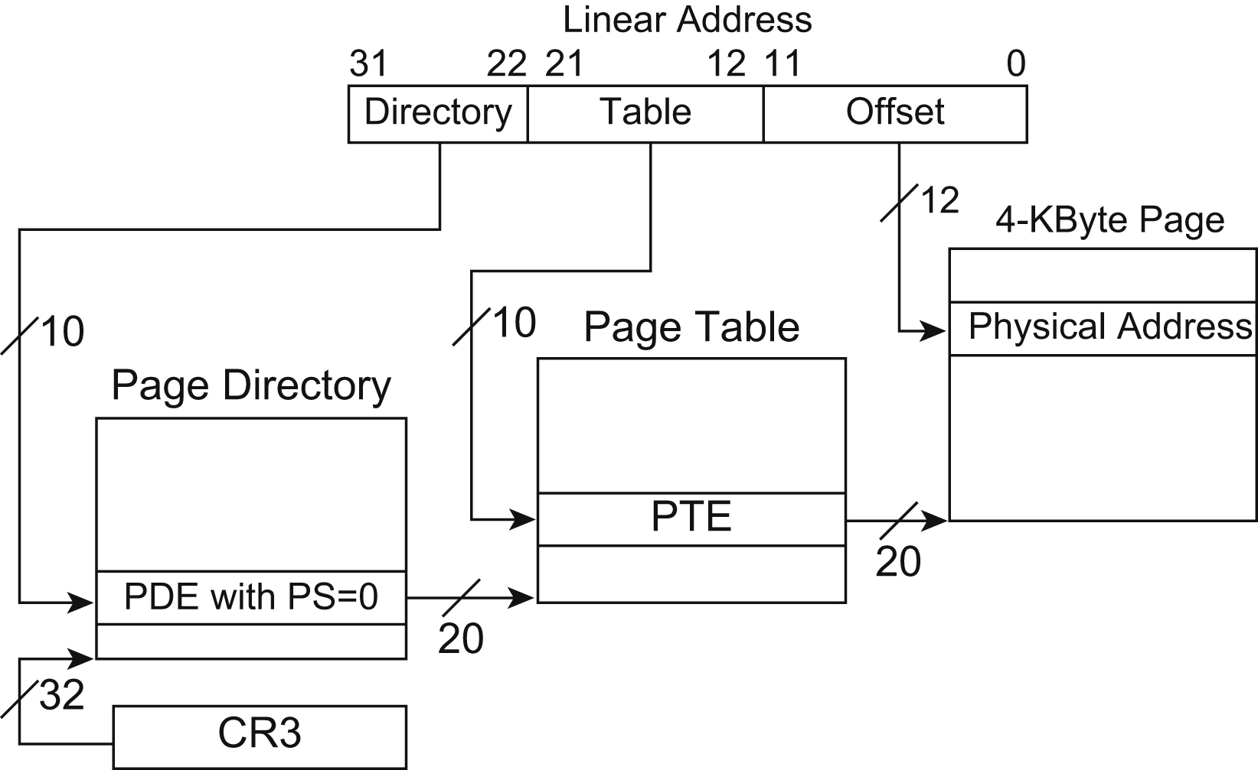
Address Translation

Slide 22
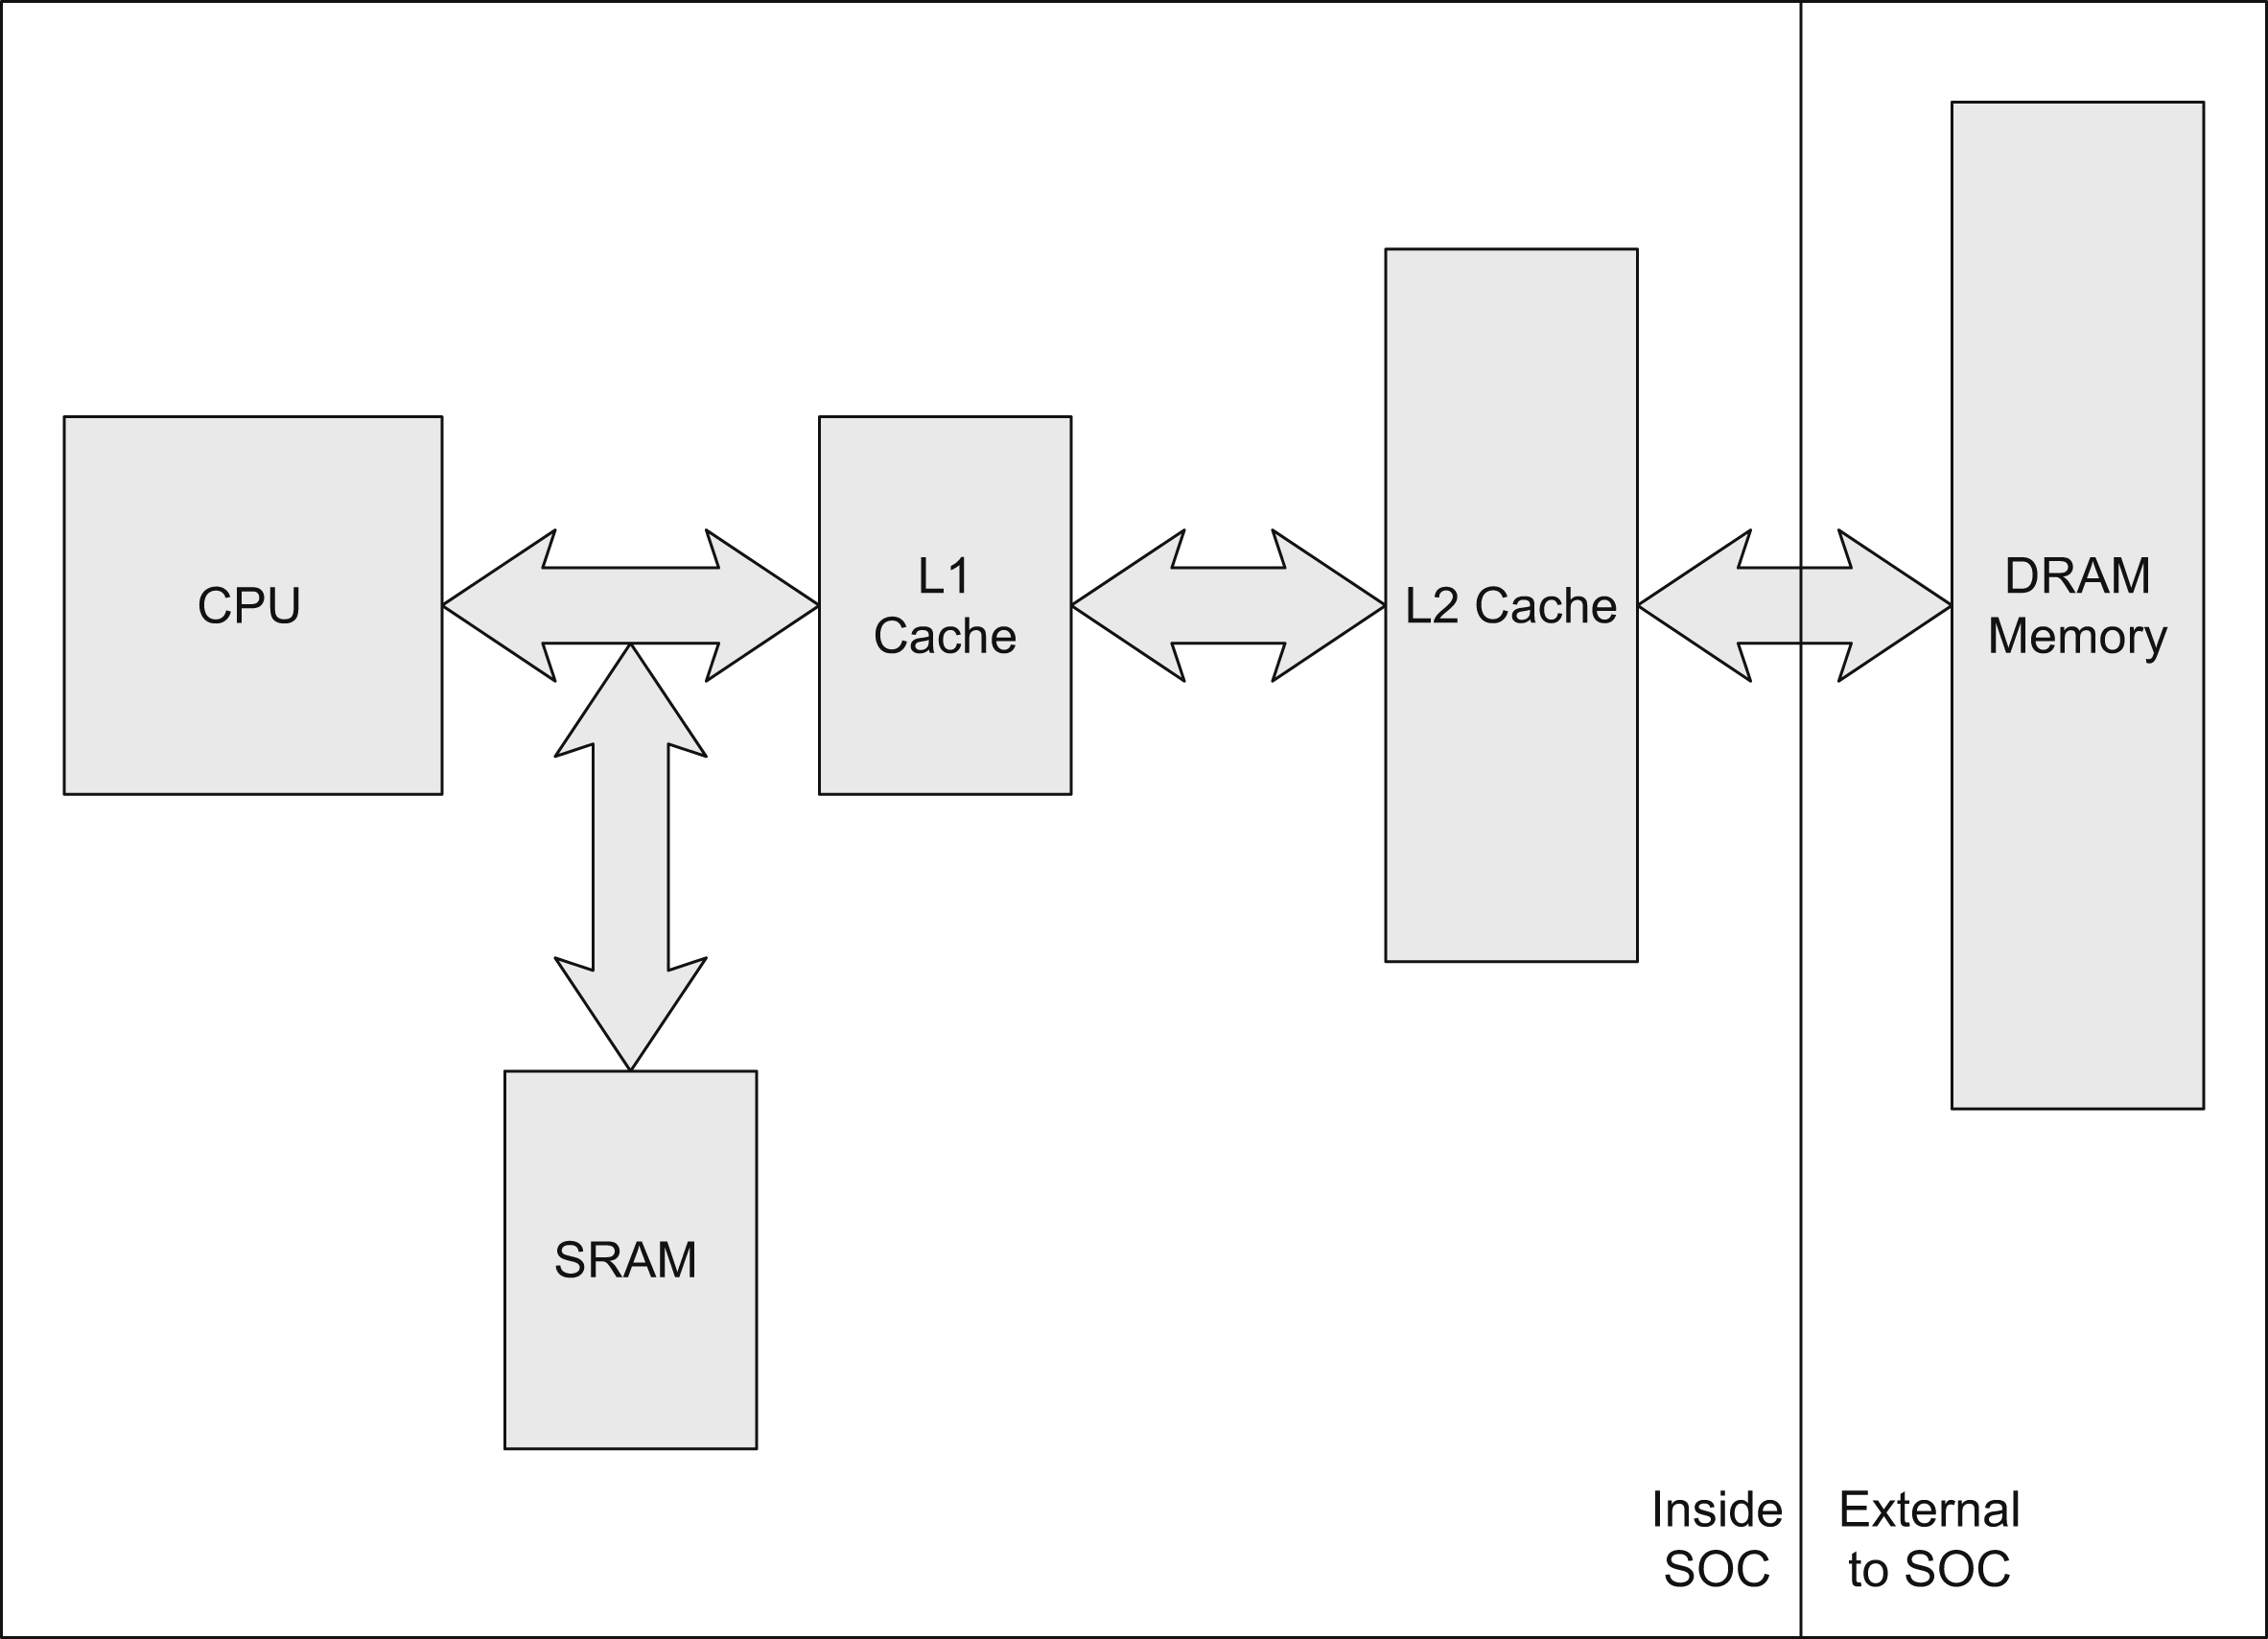
Memory Hierarchy
CPU Stalls
  Often caused on read operations
  Write buffering to avoid write stalls
Logic Gate Memory
  Buffering
Static RAM (SRAM)
  Access time: 1-2 CPU Core Clocks
Dynamic RAM (DRAM)
  100 ns
Mass Storage
  Very Slow, 1000s cycles

Slide 23
Cache Hierarchy
Temporal locality
  If a memory location was accessed then it is likely to be accessed again soon
Spatial locality
  A program is likely to access a memory address close to the current access
Hierarchy
  CPU -> L1 -> L2
    L2 is slower as it is larger, and farther away
Cache allocation
  Evicts data based on a missed memory read

Slide 24
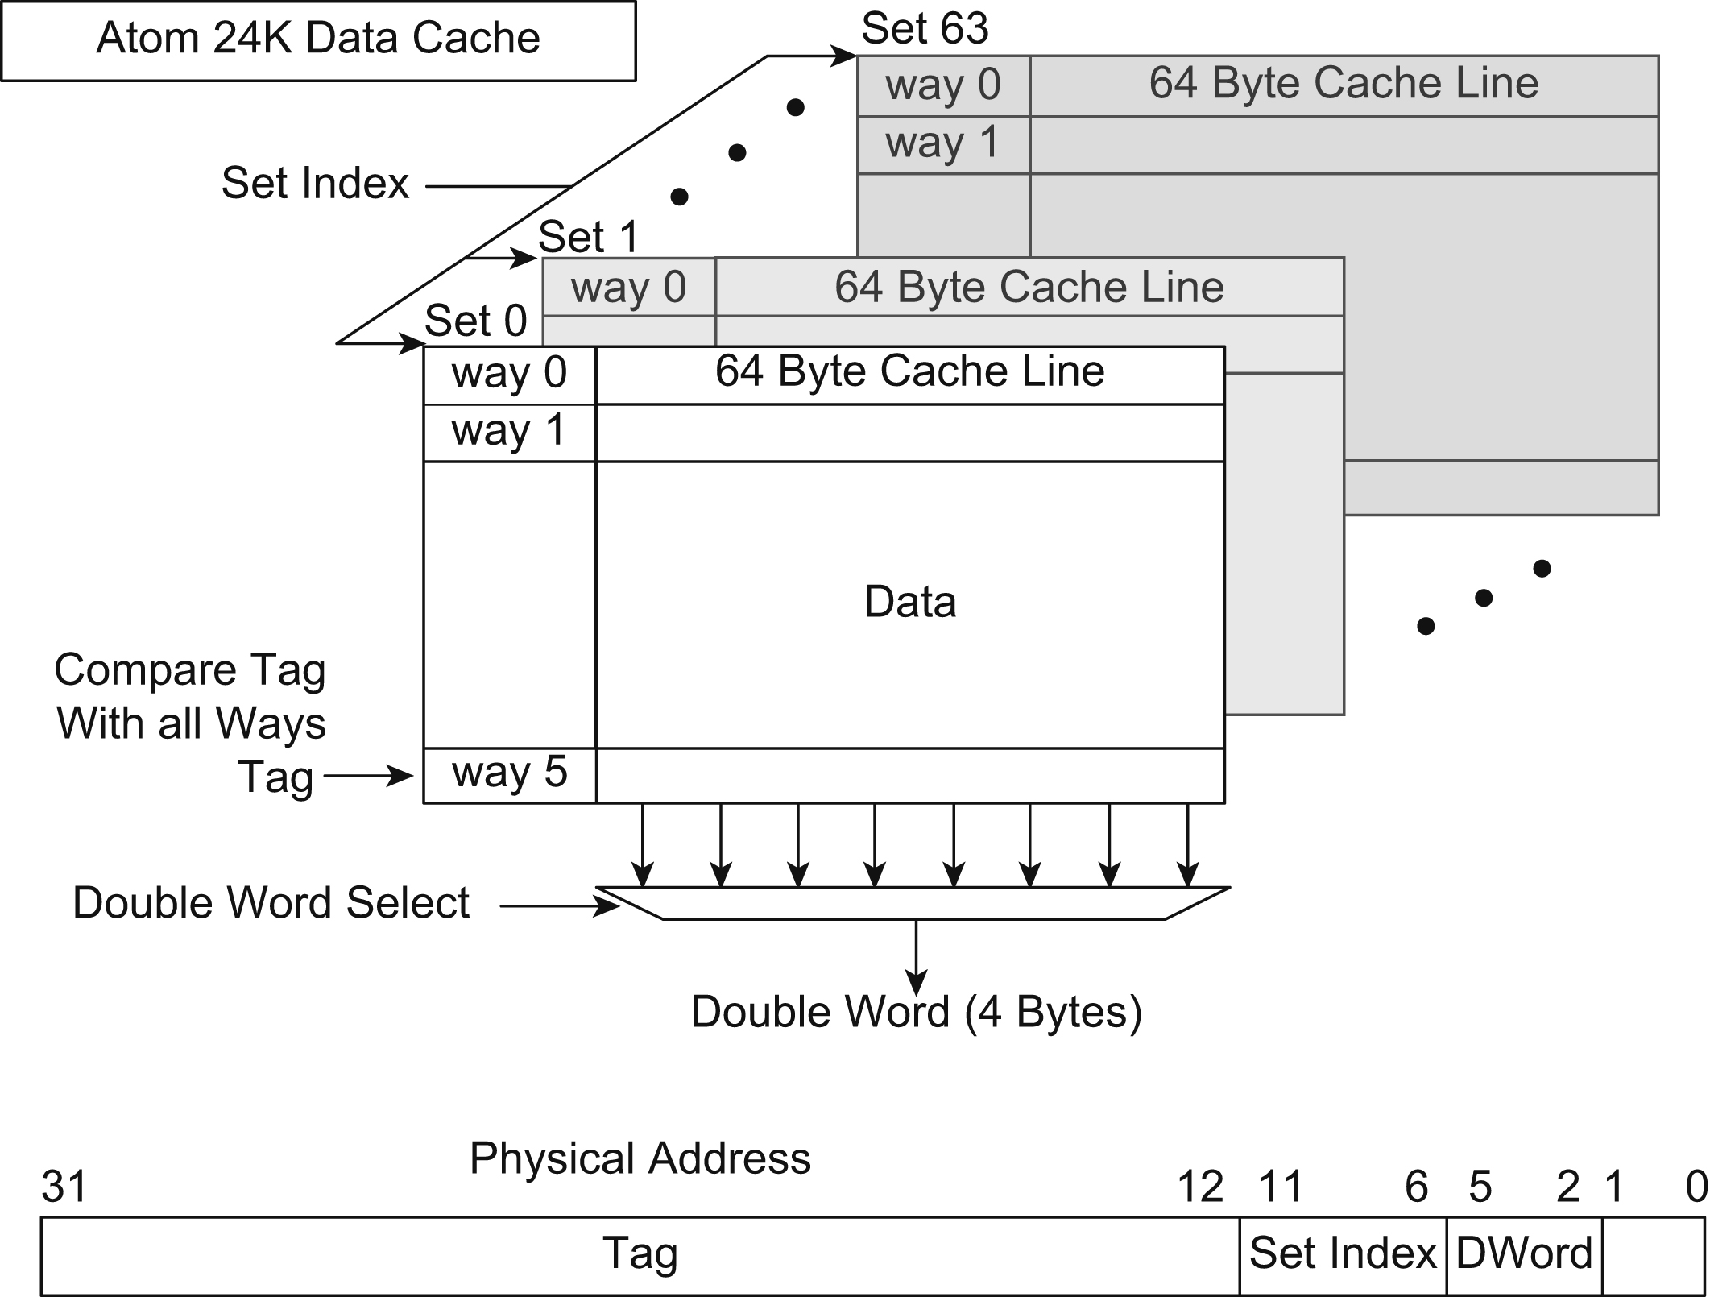
Six-Way Set Associative 24K

Slide 25
Cache Coherency
Ensures that content from peripherals is correct
  Responsibility of drivers
Snoop Cycles
  Processor snoops during memory transactions
Cache Flushing
Simplifies software development and debugging
Multicore Processors use MESI to share cache data

Slide 26
MESI
(Modified, Exclusive, Shared, Invaled)
  Stands for the different states of cache
MESI is widely popular in muliprocessor designs such as:
  Intel architectures, ARM11 and ARM Cortex-A9 MPCores

Slide 27
System Bus
Bus Addresses
  PCIe offers direct memory access to the system memory
    Create addresses that relate to a physical system address
    Device drivers convert virtual addresses to physical addresses
  Intel PCIe bus is 1:1 with the physical addresses
  SoC’s however require a translation
System Bus Interface
  Front Side Bus (FSB)
    Connects CPU and Memory Controller Hub

Slide 28
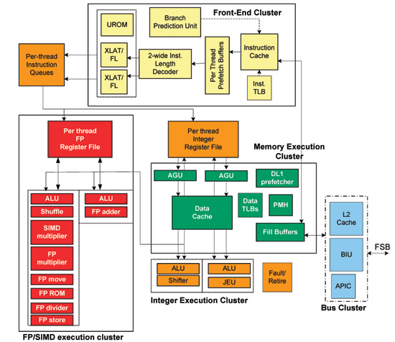

Slide 29
Summary
Concepts with processor within SOC
Basic execution environment
Application binary interface
Instruction classes
Interrupts
Memory mapping and protection
Memory hierarchy

